Slide 1
Using Statistics for Better Business Decisions
Justin Bateh and Bert G. Wachsmuth
Copyright © Justin Bateh and Bert G. Wachsmuth, 2016. All rights reserved.

Slide 2
Chapter 7 Association Between Categorical Variables
Using Statistics for Better Business Decisions
Copyright © Justin Bateh and Bert G. Wachsmuth, 2016. All rights reserved.

Slide 3
Learning Objectives
Understand row and column percentage tables and when to use which one
Use the chi-square test for contingency tables
Understand actual versus expected theory and practice
Perform a chi-square test to solve a business problem
Ch 7: Association Between Categorical Variables – Learning Objectives

Slide 4
Typical question about two variables:
Is there some relation between one variable and another, and if so, how can one use knowledge about one variable to predict, approximately, the other?
Answers to such questions can be very useful, such as:
If smoking causes cancer, we should stop smoking.
If having an advanced college degree increases the chance to have a well-paying job, we should try our best to graduate college.
If exercising increases our general state of health, we should exercise regularly.
If a new drug really does have a positive impact on lowering blood pressure, we should take it if we have high blood pressure.
Ch 7: Association Between Categorical Variables – Introduction
Notes:
Introduction
Up to this point we have analyzed data one variable at a time. We have seen how to compute measures of central tendency, estimated parameters, and tested hypothesis but each concept applied to one variable at a time.
Now we want to investigate two (or more) variables simultaneously to discover any potential relation between them.

Slide 5
Difficult to determine whether two variables (such as smoking and cancer) are indeed related and even harder to determine whether there is a causal relationship between them
i.e. which is cause and which is result (If smokers have higher cancer rates, does smoking cause cancer or does having cancer somehow induce you to smoke?)
In general, correlation does not necessarily imply causation.
The more firemen are fighting a fire, the bigger the fire is observed to be. Therefore, firemen cause an increase in the size of a fire.
Sleeping with one’s shoes on is strongly correlated with waking up with a headache. Therefore, sleeping with one’s shoes on causes headaches.
Ch 7: Association Between Categorical Variables – Introduction

Slide 6
Obviously, both conclusions are wrong.
First case: The causal relationship goes the other way (a bigger fire requires more firemen)
Second case: There is an “invisible” third condition that causes both events of sleeping with one’s shoes on and waking up with a headache
Ch 7: Association Between Categorical Variables – Introduction

Slide 7
Example
The residents of Green Township were asked their opinion about a new Zoning Ordinance. The answers were broken down by age of the people who were questioned.
The results of the survey are summarized in Table 7.1. Convert these figures into percentages.
Table 7.1 Results of survey about zoning law
Ch 7: Association Between Categorical Variables – Two-Dimensional Data Summary

Slide 8
Expand the table by including all possible row and column totals
Ch 7: Association Between Categorical Variables – Two-Dimensional Data Summary
Notes:
This example does not seem clear. To convert a number into percentages, we need to know the total out of which this number represents a percentage. But for the preceding table it is not clear which figure to use as total, so as a first step we expand the table by including all possible row and column totals (see Table 7.2).

Slide 9
Convert any number into three percentage values.
For example, there are 92 people aged 50 or under who voted for the zoning law.
In terms of percentage, we could say:
92 out of a total of 179 (51.4 percent) people for the zoning law are aged 50 or under.
92 out of a total of 250 (36.8 percent) people aged 50 or under were for the zoning law.
92 out of a total of 412 (22.3 percent) people were aged 50 or younger and for the zoning law.
Ch 7: Association Between Categorical Variables – Two-Dimensional Data Summary

Slide 10
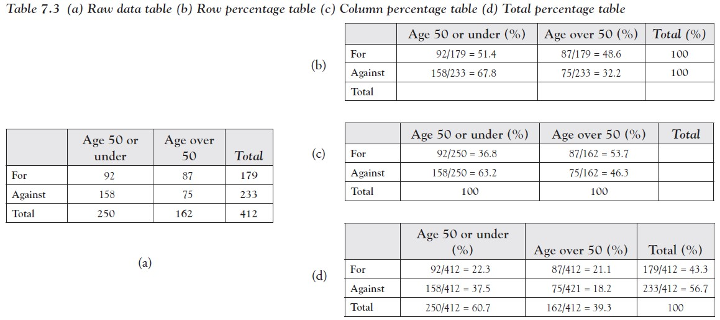
Row percentage table using the row totals (Table 7.3b)
Column percentage table using the column totals (Table 7.3c)
Total percentage table using the overall total (Table 7.3d)
Ch 7: Association Between Categorical Variables – Two-Dimensional Data Summary
Notes:
Three possible percentage tables we could create from the preceding data.

Slide 11
The total percentage table turns out to be not useful but row and column percentages are; the question is when to use which. Consider two similar but very much different questions.
How many people, in percentage, who are for the zoning law are aged 50 or under?
How many people, in percentage, 50 or under are for the zoning law?
These questions seem similar:
We are looking at the intersection between the row “For zoning” and the column “Age 50 or under.”
From the first table we know that 92 people fall into that category, but that number is not in percentage.
Ch 7: Association Between Categorical Variables – Row Versus Column Percentages

Slide 12
On the other hand, there are two candidates for the percentage number, 51.4 percent from the row percentages or percent from the column percentages. Which one answers which question?
Question 1 asks, rephrased: Out of all people who are for the zoning law, how many of them are aged 50 or under?
In other words, question 1 considers all people who are for the zoning law as a total—that is a row total, so that the answer to question 1 is the row percentage 51.4 percent.
Question 2 asks, rephrased: Out of all people who are 50 or under, how many of them are for the zoning law?
In other words, question 2 considers all people who are 50 or under as a total—that is, a column total, so that the answer to question 2 is the column percentage 36.8 percent.
Ch 7: Association Between Categorical Variables – Row Versus Column Percentages

Slide 13
From this example we see that the key to answering questions such as these is which group is considered the “total” group for the particular question.
If the total for that group is found in a row, use row percentages.
If the total for that group is found in a column, use column percentages.
Ch 7: Association Between Categorical Variables – Row Versus Column Percentages
Notes:
It seems that generating these percentage tables is a fair amount of work. Of course Excel provides an easier method for generating such tables from actual data, which we will explore soon.

Slide 14
Example
Load the following Excel data file, which lists salary and other information about employees of a particular company.
Create and interpret tables relating:
Gender with Salary Level
Salary Level with Years of Education
Salary Level with Job Category
www.betterbusinessdecisions.org/data/employeeselected.xls
Ch 7: Association Between Categorical Variables – Contingency Tables
Notes:
In an earlier chapter we saw how to use Excel’s “Pivot” function to compute counts or frequencies, using one (categorical) variable at a time.
Now we want to generate tables involving two variables from a particular data set (review the “Bending the Rules: Lying or Exaggeration” section if necessary).

Slide 15
With Excel, the appropriate tool to create such crosstabs tables for categorical variables is the “PivotTable …” in the “Insert” ribbon.
Load the preceding spreadsheet into Excel.
Click “Insert” and then “PivotTable ….”
Use the range selector tool to select the entire data set.
Ch 7: Association Between Categorical Variables – Contingency Tables

Slide 16
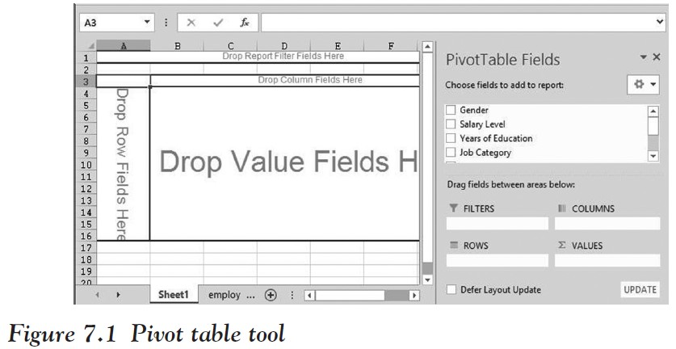
You will then see a table where you can drag variables from the PivotTable fields into the “Row,” “Column,” or “Values” areas.
We will not make use of “Filters”.
Ch 7: Association Between Categorical Variables – Contingency Tables

Slide 17
To analyze the relationship—if any—between “Gender” and “Salary Level”:
Drag the variable “Salary Level” to the “Row” field of the table and the variable “Gender” to the “Column” field
If you accidentally drop a variable in the wrong spot, simply drag it back.
This will create a table with “Salary Levels” as rows and “Gender” as columns, but containing no data yet.
Ch 7: Association Between Categorical Variables – Contingency Tables

Slide 18
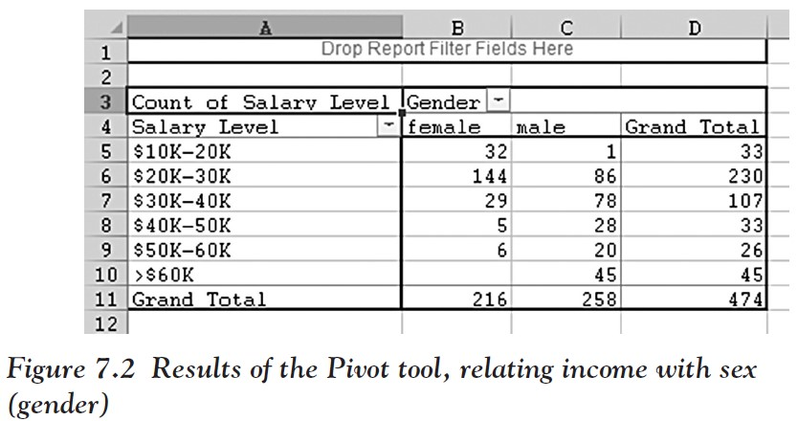
Finally, drag either “Gender” or “Salary Level” into the “Data” field in the middle (in our case it does not matter which one but in Figure 7.2 we used “Salary Level”) and the table will be complete—but with raw data, not percentages.
This table shows, for example, that 32 female employees out of 474 total employees earn between $10,000 and $20,000, while, for example, 45 male employees earn more than $60,000.
Ch 7: Association Between Categorical Variables – Contingency Tables

Slide 19
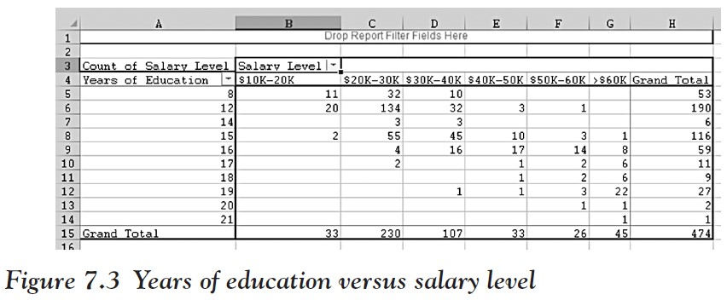
Similarly, we can create tables to relate “Salary Level” with “Years of Education”.
Simply drag the “Salary Level” and “Gender” variables out of the table
Drag the “Years of Education” and “Salary Level” into the respective row, column, and data area to create the table shown in Figure 7.3.
Ch 7: Association Between Categorical Variables – Contingency Tables
Notes:
Similarly, we can create the table relating “Salary Level” with “Job Category”; details are left to you. To finish our discussion, we use the preceding tables to answer specific questions.

Slide 20
Example
Using the Excel data as before, answer the following questions in percentage.
How many female employees earn less than $40,000? How many males?
How many people earning more than $60,000 have 15 years of education or less? How many have more than 15 years of education?
Ch 7: Association Between Categorical Variables – Contingency Tables

Slide 21
To answer question 1, generate a table relating salary with gender
Use salary as the row variable and gender as the column variable
Ch 7: Association Between Categorical Variables – Contingency Tables
Notes:
At first glance it might seem that we have already created the right tables to answer these questions (see Figures 7.2 and 7.3).
However, this time we want the answers in percentage, while our preceding tables contain actual numbers. And, as we have discussed in the previous section, when we want to generate percentage tables we need to decide whether we want row or column percentages.

Slide 22
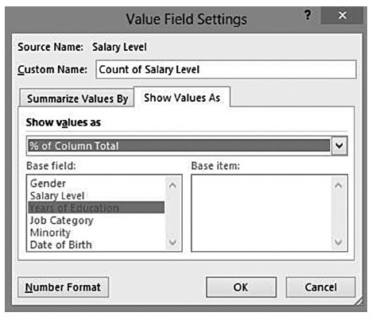
Question 1 uses as total all female employees, and in our table the “females” go along a column.
Therefore, we need to generate column percentages.
Double-click the “Count of Salary Level” button in your table
Click on “Options” in the dialog that pops up
Select “% of column” in “Show values as”
Figure 7.4 Value field settings for Pivot table
Ch 7: Association Between Categorical Variables – Contingency Tables

Slide 23
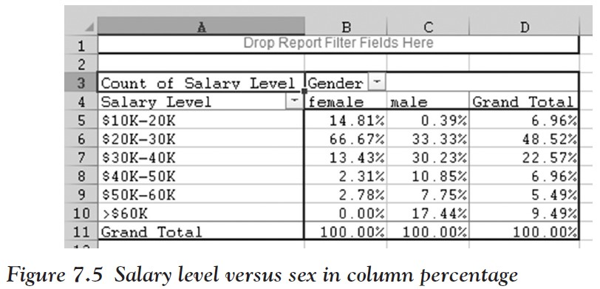
You should see the final table, containing column percentages.
Note that you can see that the table shows column percentages since the percentages across the columns add up to 100 percent.
Ch 7: Association Between Categorical Variables – Contingency Tables

Slide 24
Now we can answer question 1 easily: “How many female employees earn less than $40,000?”
In the female column we need to add the numbers:
14.81% + 66.67% + 13.43% = 94.91%
For the male employees:
63.95 percent of males earn less than $40,000
Ch 7: Association Between Categorical Variables – Contingency Tables
Notes:
Actually, this seems to indicate that female employees, as a rule, earn less money than male employees. We will learn how to answer questions such as these in the next section.

Slide 25
It is left as an exercise to answer question 2:
“How many people earning more than $60,000 have 15 years of education or less?
“How many have more than 15 years of education?”
Figure 7.6 shows the particular table we need to figure out the answers.
Ch 7: Association Between Categorical Variables – Contingency Tables

Slide 26
Is that table using row or column percentages?
The correct answers:
2.22 percent of people earning more than $60,000 have 15 years or less of education
97.78 percent of people earning more than $60,000 have more than 15 years of education
Ch 7: Association Between Categorical Variables – Contingency Tables
Notes:
Again, a more interesting question would be to determine whether more years of education generally result in higher salaries (it does look that way)—we will answer that type of question in the next section.

Slide 27
Two variables are related if changing the value of one will also change the value of the other.
Dependent variable – the variable that changes as a result of changing the other one
Independent variable – the other variable
Note that the independent variable usually occurs first in time.
Ch 7: Association Between Categorical Variables – The Chi-Square Test for Categorical Crosstabs
Notes:
In the previous section we computed crosstabs tables, analyzing two categorical variables simultaneously. A natural question to ask now is:
Is there a statistically significant relationship between two (categorical) variables, or do they appear to be independent?

Slide 28
Example
Consider the crosstabs table relating income with sex for a particular company as shown in Figure 7.2.
Identify independent and dependent variables.
Ch 7: Association Between Categorical Variables – The Chi-Square Test for Categorical Crosstabs

Slide 29
We do not know yet whether there is a relation between the two variables.
But if there was, sex would certainly be the independent variable, while salary would be the dependent one.
Thus, if there was a relation, gender would have an impact on the salary a worker makes.
It is pretty clear that it cannot be the other way round: A change in salary level will certainly not change your gender.
Note that gender is indeed determined prior to salary in time.
Ch 7: Association Between Categorical Variables – The Chi-Square Test for Categorical Crosstabs

Slide 30
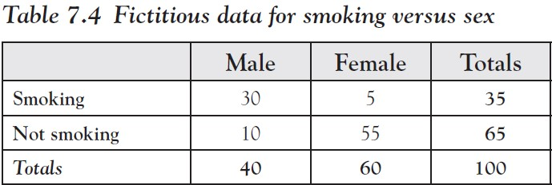
Let us say we are interested in figuring out whether there is a relation between sex (male/female) and smoking (yes/no), or whether the two variables are independent of each other.
We conduct an experiment and ask a randomly selected group of people for their sex and whether they smoke.
Then we construct the corresponding crosstabs table. Let us say the response is as shown in Table 7.4 (the actual numbers are fictitious).
Of the 35 people who smoke, 30 of them are male.
Conversely, of the 65 people who do not smoke, 55 of them are female.
Ch 7: Association Between Categorical Variables – Actual Versus Expected Theory
Notes:
Such an outcome—using common sense—would suggest that there is a relation between smoking and sex, because the vast majority of smokers are male, while the majority of nonsmokers are female.

Slide 31
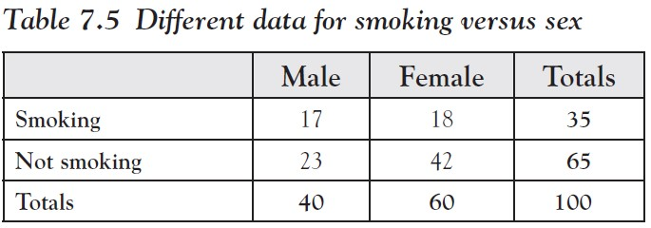
On the other hand, we might have obtained results as in Table 7.5 (again with fictitious numbers).
In Table 7.5 the smokers and nonsmokers are divided more evenly among men and woman, suggesting perhaps that the two variables are independent of each other (a person’s sex does not seem to have an impact on their smoking habit).
Ch 7: Association Between Categorical Variables – Actual Versus Expected-Theory

Slide 32
Now let us see exactly how a table should look if we assume that two variables are indeed independent.
Suppose we are again conducting our experiment and select some random sample, but for now we only look at totals for each variable separately (the actual numbers are once again fictitious).
Suppose, for example:
Number of smokers is 35 and number of nonsmokers is 65.
Number of males is 40 and number of females is 60.
Total number of data values (subjects) is 100.
Ch 7: Association Between Categorical Variables – Actual Versus Expected-Theory

Slide 33
With this information we could construct a crosstabs table as in Table 7.6.
Ch 7: Association Between Categorical Variables – Actual Versus Expected-Theory

Slide 34
But what kind of distribution in the various cells would we expect if the two variables were independent?
We know that 35 of 100 (35 percent) smoke
There are 40 males and 60 females—if being male and female had nothing to do with smoking (the variables were independent), we would expect that 35 percent of the 40 males and 35 percent of the 60 females smoke.
We also know that 65 of 100 (65 percent) do not smoke
There are 40 males and 60 females—if the two variables were independent, we would similarly expect that 65 percent of the 40 males and 65 percent of the 60 females do not smoke.
Ch 7: Association Between Categorical Variables – Actual Versus Expected-Theory

Slide 35
Under the assumption of independence we would therefore expect the numbers shown in Table 7.7.
Ch 7: Association Between Categorical Variables – Actual Versus Expected-Theory

Slide 36
Note that the cells automatically add up to the correct row and column totals.
In other words, if a crosstabs table with two rows and two columns has row totals $r_{1}$ and $r_{2}$, respectively, and column totals $c_{1}$and $c_{2}$, then if the two variables were independent we would expect the complete table to look like:
Ch 7: Association Between Categorical Variables – Actual Versus Expected-Theory

Slide 37
Expected Values
We create a table of expected values as follows.
Create a crosstabs table as usual, containing the actual or observed values (not percentage).
Create a second crosstabs table where you leave the row and column totals as observed, but replace the count in the i-th row and j-th column by:
(total of row i) * (total of column j)/(overall total)
Fill in all cells in this way and call the resulting crosstabs table the expected values table, because these numbers would be expected in this table cell if the two variables under investigation were independent.
Ch 7: Association Between Categorical Variables – Actual Versus Expected-Theory
Notes:
Now that we know what distribution to expect if two variables were independent and we can compare it against the actual distribution of numbers: if it is not close to the conjectured distribution, then the variables cannot be independent and thus they must be related!
With that in mind we create an effective procedure to test whether two variables are independent. First we define the table of expected values as follows.

Slide 38
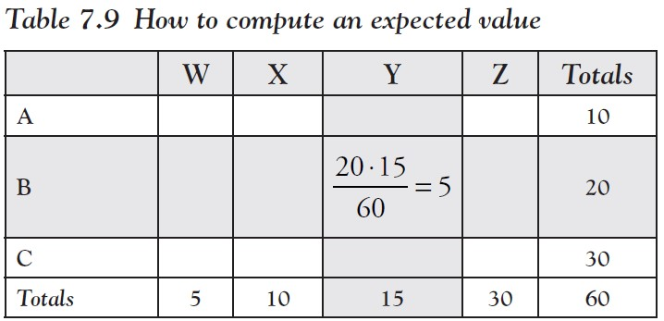
For example, the expected value in the second row B and third column Y of Table 7.9 would be $\frac{20 ∙ 15}{60}$ = 5
Ch 7: Association Between Categorical Variables – Actual Versus Expected-Theory
Notes:
Now, here is the clue: If the actual values are very different from the expected values, the conclusion is that the variables cannot be independent after all (because if they were independent the actual values should look similar to the expected values).

Slide 39
Total Difference
Let $v_{a}$ be the actual value and $v_{e }$the expected value in a cell of a crosstabs table.
The total difference between the actual and expected values is defined as the sum of $\frac{{( v_{a} − v_{e})}^{2}}{v_{e}}$ , where the sum is taken over all cells of the table
This total difference is denoted by $x^{2}$(chi-squared):
$x^{2}$ = $\sum{\frac{{( v_{a} − v_{e})}^{2}}{v_{e}}}$
Ch 7: Association Between Categorical Variables – Actual Versus Expected-Theory

Slide 40
Recall our earlier example comparing smoking versus gender.
We had two hypothetical tables of actual values.
For each table we compute the expected value in each cell and show it in parenthesis.
Then we compute the total difference $x^{2 }$as defined earlier for both tables.
Ch 7: Association Between Categorical Variables – Actual Versus Expected-Example
Notes:
The only question left to answer is: “Exactly when is this difference too large? That is: At which point can we assume that the difference between expected and actual values is so large that we have to conclude that the variables cannot be independent? Before we answer that question, let us return to our original example.

Slide 41
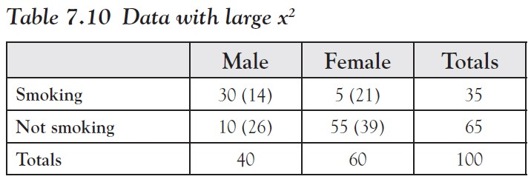
For Table 7.10 common sense told us that the two variables were not independent and the chi-square difference turned out to be $x^{2 }$ = 46.89.
Ch 7: Association Between Categorical Variables – Actual Versus Expected-Example
Notes:
The only question left to answer is: “Exactly when is this difference too large? That is: At which point can we assume that the difference between expected and actual values is so large that we have to conclude that the variables cannot be independent? Before we answer that question, let us return to our original example.

Slide 42
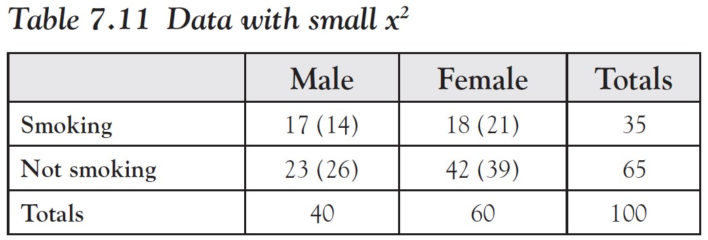
For Table 7.11 we figured that the two variables could very well be independent and the chi-square difference worked out to $x^{2 }$ = 1.65.
Ch 7: Association Between Categorical Variables – Actual Versus Expected-Example
Notes:
Note: We compute the value of $x^{2 }$ here (and in some other examples) manually, which can be quite a lot of work. In real life, we will of course use software such as Excel for that; so if you feel that computing $x^{2 }$ is just too much, do not worry, we will soon show how to use Excel for this.

Slide 43
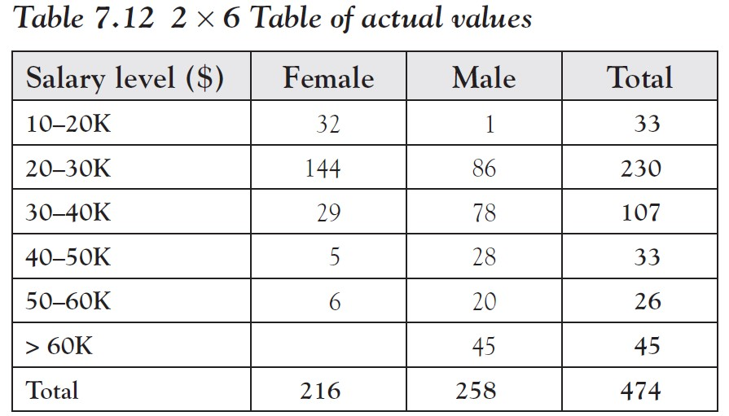
We developed our algorithm for the expected values using a 2 × 2 table, but that algorithm easily extends to n × m tables, that is, tables with n rows and m columns.
Suppose, for example, we wanted to determine whether sex (gender) and salary level in the particular company are related to each other.
We create a table relating the two variables, such as Table 7.12 of actual values.
Note that the table with actual values must contain counts, not percentages.
Ch 7: Association Between Categorical Variables – Actual Versus Expected-Example

Slide 44
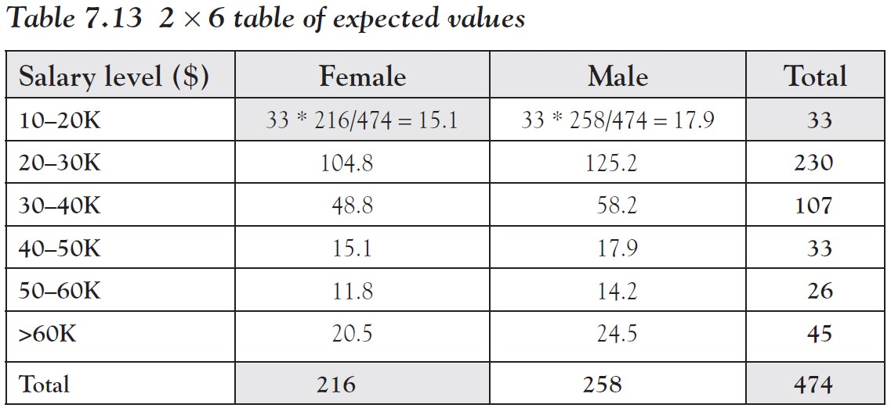
To compute the table of expected values, each entry is computed as the product of the row and column total for that cell divided by the overall total.
Note that the row and column totals add up correctly (except for rounding errors).
If we compare expected versus actual values in Tables 7.12 and 7.13, we see that of the people making $60K or more, fewer than expected are female (0 versus 20.5) while more than expected are male (45 versus 24.5).
On the other hand, in the low-income category of $10 to $20K, more than expected are female (32 versus 15.1) while fewer than expected are male (1 versus 17.9).
Ch 7: Association Between Categorical Variables – Actual Versus Expected-Example

Slide 45
This seems to point toward a gender bias for salaries
i.e. Women make less money than men as a rule, or to phrase it differently: row and column variables do not seem independent of each other
Indeed, if we compute the total difference, we get $x^{2}$= 131.9, which is quite large.
However, in a table with many rows and columns the total difference $x^{2}$ can get quite large even though each individual difference between the actual and the expected value is small, merely because we are adding up more and more terms.
Ch 7: Association Between Categorical Variables – Actual Versus Expected-Example
Notes:
Thus, the big question left is: When is the difference small enough for us to accept the independence assumption, and when is the difference so large that we can no longer assume independence and must therefore accept dependence?
The answer to this question is provided by the chi-square test.

Slide 46
The Chi-Square Test
A chi-square test of independence consists of the following four parts.
Null hypothesis $H_{0}$: the two variables are independent
Alternative hypothesis $H_{a}$: the two variables are dependent
Test statistics: $x^{2}$ = $\sum{\frac{{( v_{a} − v_{e})}^{2}}{v_{e}}}$, where $v_{a }$is the actual and $v_{e }$ the expected value in each cell of a contingency table
Rejection region: Compute the p value, which depends on the value of the test statistics $x_{2}$ and also on the number of rows and columns.
If the probability value p is small, differences between actual and expected values are judged to be significant (large) and therefore you reject the null hypothesis of independence and accept the alternative that the variables are related.
If p is large, the test is inconclusive.
Ch 7: Association Between Categorical Variables – The Chi-Square Test
Notes:
Typically, values of p = 0.05 or less are considered small enough to reject independence; the closer p is to zero the more convincing the relationship is.

Slide 47
Rule of Thumb for a Chi-Square Test
One important restriction states that the chi-square test is not appropriate if any of the expected values is less than 5.
You need to manually inspect all expected values to ensure none of them have a value less than 5.
How exactly is the value of p computed?
Use the Excel function p = chisq.test(actual_range, expected_range) where
actual_range is the range for the actual values
expected_range is the range for the expected values
Note that we do not need to compute the value of $x^{2}$; the = chisq.test function will take care of that.
Ch 7: Association Between Categorical Variables – The Chi-Square Test

Slide 48
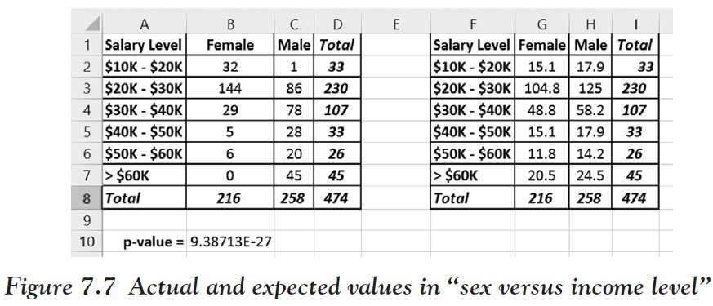
Example
Use a chi-square test to determine if salary and gender are related.
We have created the tables of actual and expected values.
Ch 7: Association Between Categorical Variables – The Chi-Square Test

Slide 49
We need to check all expected values but none is less than 5.
The value of p is computed via Excel with the command =CHISQ.TEST(B2:C7,G2:H7)
Turns out to be p = 9.38713E−27, which is the scientific notation for 0.00000000000000000000000000938713
Thus, p is most definitely small, so we reject the null hypothesis of independence and conclude that there is a relation between the two variables sex and salary.
In other words, the salary level in this particular company does depend on the sex of the employees.
Ch 7: Association Between Categorical Variables – The Chi-Square Test

Slide 50
Example
Using the following data set, is there a relation between salary and years of schooling?
www.betterbusinessdecisions.org/data/employeeselected.xls
Ch 7: Association Between Categorical Variables – The Chi-Square Test

Slide 51
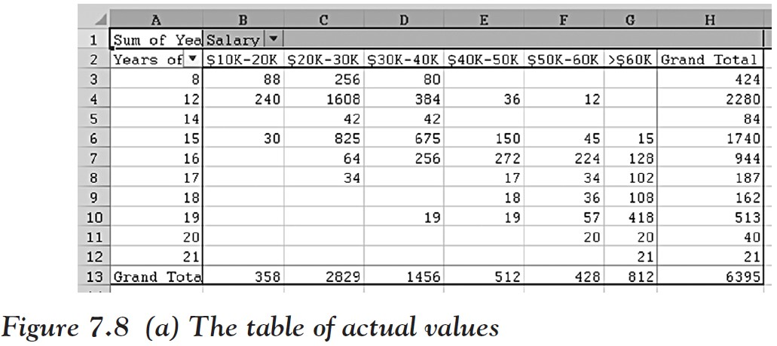
After loading the data and working out the actual values via Excel’s Pivot tool, we compute the expected values, which is a lot of work.
Ch 7: Association Between Categorical Variables – The Chi-Square Test

Slide 52
Ch 7: Association Between Categorical Variables – The Chi-Square Test

Slide 53
Finally, we compute the chi-square test value p, again with the help of Excel: p = 0.00.
Again the value of p is for all intent and purposes 0, so it seems that we can with a high degree of certainty conclude that there is a relation between years of education and the salary level.
In other words, based on this data you make more money with more years of education, just like your parents told you.
Ch 7: Association Between Categorical Variables – The Chi-Square Test

Slide 54
But we failed to check if the expected values pass our “rule-of-thumb” test!
In fact, quite a few of the expected values are small, certainly smaller than 5.
Thus, in this case the chi-square test is not reliable and we should not believe its conclusions since the assumptions of the test were not satisfied!
To remedy the problem, you could recategorize the data by using fewer groups so that hopefully the expected values in the new tables will all be above 5.
Ch 7: Association Between Categorical Variables – The Chi-Square Test

Slide 55
Example
Every year there are large-scale surveys, selecting a representative sample of people in the United States and asking them a broad range of questions. One such survey is the General Social Science (GSS) survey from 1996 (which contains mostly categorical data).
Use the data (which is real-life data from 1996) to analyze if there is a relation between party affiliation and people’s opinion on capital punishment.
www.betterbusinessdecisions.org/data/gss96-selected.xls
Ch 7: Association Between Categorical Variables – The Chi-Square Test

Slide 56
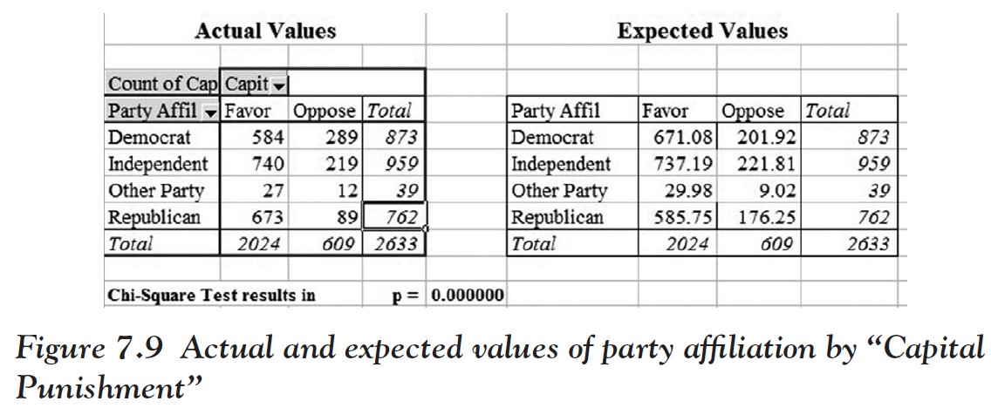
After downloading and opening the data file, we construct a crosstabs table for “Party Affil” and “Capital Punishment” using the Pivot table
Copy the table (of actual values) to a second table and construct the expected values as described earlier (this time the table is pretty small, so computing the expected values is not that much work).
Ch 7: Association Between Categorical Variables – The Chi-Square Test

Slide 57
Finally, we use Excel to compute the value of p = 0.00000 (to six digits of accuracy).
Before jumping to any conclusion, we check our rule of thumb:
This time the smallest expected value is 9.02, which is above 5 so that it is valid to apply our chi-square test.
Again p is very close to 0, implying that there is a relation between party affiliation and opinion on capital punishment.
In fact, if you compare the actual versus expected values directly for the Democrats you can see that fewer Democrats than expected favor the death penalty, while more than expected oppose it.
For Republicans it is just the other way round
For independents and people with other party affiliations there seems to be little difference between actual and observed values.
Ch 7: Association Between Categorical Variables – The Chi-Square Test
Notes:
So far in all our examples the variables were dependent. Of course that is not always the case.

Slide 58
Example
Set up the corresponding tables for actual and expected values for the data from the GSS96 survey relating people’s outlook on life (variable “Life is”) with their opinion on “Capital Punishment” and complete a chi-square test for independence at the alpha = 0.01 level.
Ch 7: Association Between Categorical Variables – The Chi-Square Test

Slide 59
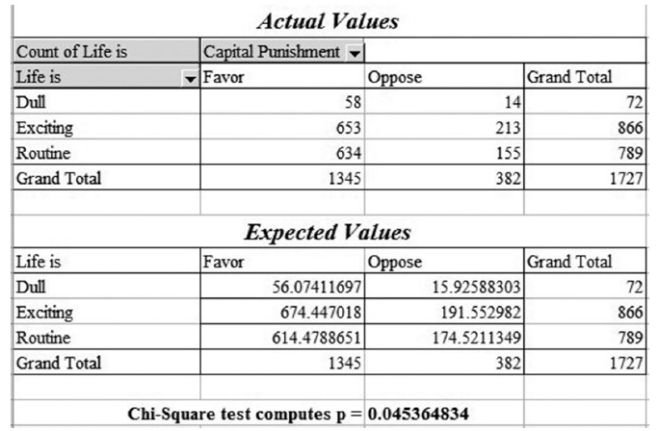
After constructing the tables as required (see Figure 7.10) we see that the computed p value is p = 0.045, which is larger than the required alpha level of 0.01.
Thus, our test is inconclusive.
We cannot conclude that the variables are dependent.
Note that all expected values are bigger than 5, so our chi-square test does apply.
Figure 7.10 Actual and expected values for “Life is …” versus opinion on “Death Penalty”
Ch 7: Association Between Categorical Variables – The Chi-Square Test

Slide 60
Example
Below is the GSS Survey 2008 data file. This data set is similar to the GSS survey from 1996 but it contains a lot more variables and more recent data.
Is there a relation between being born in the United States and gender?
www.betterbusinessdecisions.org/data/gss2008-short.xls
Ch 7: Association Between Categorical Variables – The Chi-Square Test

Slide 61
We load the data set
Create a Pivot table relating the variables “born in this country” with “sex”
Compute the expected values
Conduct a chi-square test
As it turns out, p = 0.452, which is way bigger than 0.05; so there is no reason to think the variables are not independent.
This makes sense since it is difficult to think of a reason why being born in the United States should be related to one’s gender.
The results:
Ch 7: Association Between Categorical Variables – The Chi-Square Test

Slide 62
Example
Company S, the accounting and tax strategy service firm, wants to determine if they are more suited to service large clients or smaller clients so that they can focus their efforts on the market segment most compatible with the organization. One variable they are interested in is client satisfaction. It has been thought that since they are a large firm, the larger clients they service are more satisfied with the services than the smaller clients, who may not be getting the individualized attention they expect.
Ch 7: Association Between Categorical Variables – Excel Demonstration
Notes:
Using chi-square, we are looking to see if there is a significant difference between what we would expect results to be and what the actual results were. That is, we want to compare the expected versus observed data.
We will review how to find the expected values and Microsoft Excel will help us to determine this.

Slide 63
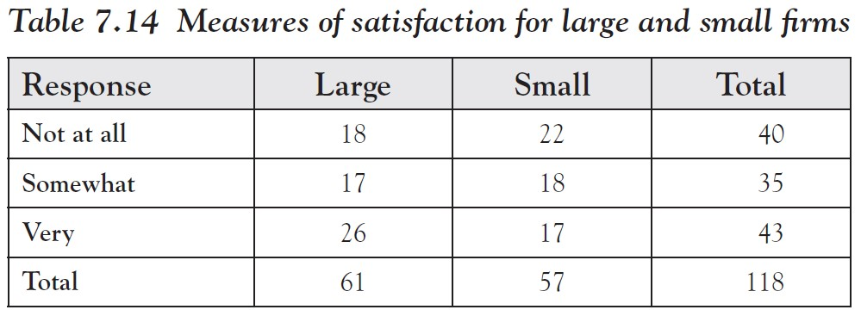
Listed in Table 7.14 are data from a survey conducted recently where large firms and small firms responded to their client satisfaction with Company S (this is fictitious data).
Ch 7: Association Between Categorical Variables – Excel Demonstration

Slide 64
Step 1:
Figure 7.12 Satisfaction data augmented by row percentages
In Excel, let us first calculate the row percentage of population responses
We will take the total responses to “Not at all” (40) and divide that by the total responses (118) to determine the percentage of respondents who responded in this category
33.89 percent of all responses were “Not at all”
29.66 percent were “Somewhat”
36.44 percent were “Very” satisfied, and so on.
We will do that for all responses
Ch 7: Association Between Categorical Variables – Excel Demonstration
Notes:
We are interested in finding out if there is a significant difference in how we expected large firms to respond and what large firms actually responded with; we follow the same method for small firms.
We will test this using a chi-square test with a cut-off value of p = 0.05.
In other words, we want to know if there is a relation between the level of satisfaction and the size of the client.

Slide 65
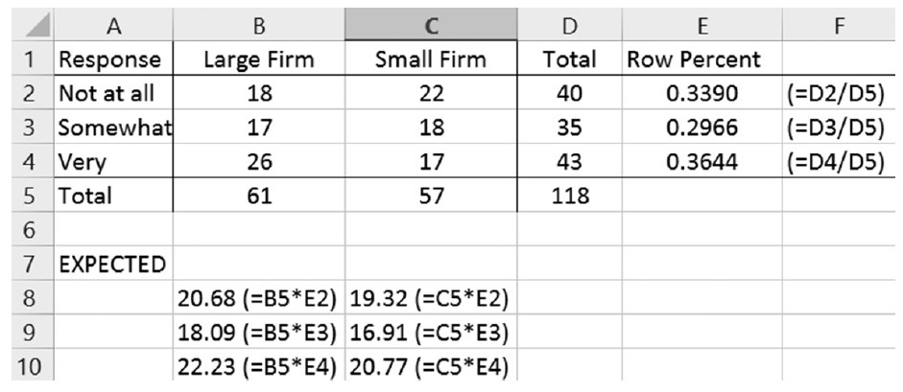
Step 2:
Since 33.89 percent of all respondents said “Not at all,” we expect to see 33.89 percent of the 61 large firms to say “Not at all,” as well as 33.89 percent of the 57 small firms, and so forth for the remaining groups, assuming the row and column variables are independent.
Figure 7.13 Actual and expected values
Create a new table with expected values by multiplying the column totals by the row percentages in each row.
Put the results below the table of actual values to create the table of expected values
Ch 7: Association Between Categorical Variables – Excel Demonstration

Slide 66
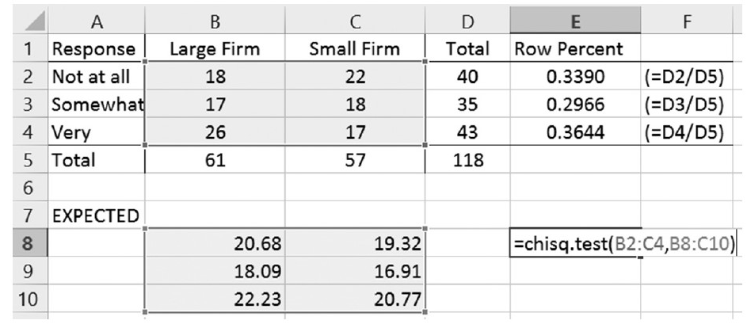
Step 3:
Figure 7.13 shows what all of our “expected” results should have been if the variables were independent, and we can compare that with our actual results by computing $x^{2}$.
Figure 7.14 Computing the p value using chisq.test
Use Excel’s CHI SQUARE TEST to compute our p-value, as shown in Figure 7.14.
Ch 7: Association Between Categorical Variables – Excel Demonstration

Slide 67
We get a p-value of 0.3363505.
This is much larger than our level of significance of 0.05, so we fail to reject the null hypothesis of independence and conclude that there is no significant evidence to prove that large firm and small firm actual results are different from the expected results of large firms and small firms in the population.
In other words, there seems to be no relation between the level of satisfaction and the size of firms.
Ch 7: Association Between Categorical Variables – Excel Demonstration

