Slide 1
Using Statistics for Better Business Decisions
Justin Bateh and Bert G. Wachsmuth
Copyright © Justin Bateh and Bert G. Wachsmuth, 2016. All rights reserved.

Slide 2
Chapter 6 Hypothesis Testing
Using Statistics for Better Business Decisions
Copyright © Justin Bateh and Bert G. Wachsmuth, 2016. All rights reserved.

Slide 3
Learning Objectives
Describe the basic principles of hypothesis testing
Use hypothesis testing to test for a mean, a difference of means, and a proportion
Evaluate the assumptions of each hypothesis-testing procedure
Avoid the pitfalls involved in hypothesis testing
Describe the ethical issues involved in hypothesis testing
Ch 6: Hypothesis Testing – Learning Objectives

Slide 4
Innocent Until Proven Guilty: Hypothesis Testing as a Trial by Jury
Consider the following case:
A company is labeling their product to weigh, on average, 10 oz. However, the last time we bought that product it only weighed 8.5 oz, so either we were unlucky to get one of the rare but possible cases where the weight differs a lot from the listed mean or the manufacturer is cheating and puts less product in the package than they are claiming on the label.
We suspect that the company is indeed cheating and want to determine whether our suspicion is true or not.
Ch 6: Hypothesis Testing – Introduction
Notes:
Introduction
In the previous chapter we investigated how to provide estimates for population parameters based on sample data, complete with error estimation. Now we want to handle “Yes or No” questions such as “Is the average weight of a bag of chips really 450 gr?” or “Is new medication X better than medication Y?”; of course we want to include an error estimate with our answer. The technical term for what we will describe in this chapter is “hypothesis testing.”

Slide 5
Innocent Until Proven Guilty: Hypothesis Testing as a Trial by Jury
If the company was correct in saying that their packages weigh 10 oz on average, it does not mean that each and every package weighs exactly 10 oz. However, it is likely that most packages weigh close to 10 oz and only a few weigh a lot less or more.
Conversely, if I found a package that weighs a lot more or a lot less than 10 oz, then it seems likely that the company’s claim may be wrong.
In fact, the chances that the original claim is incorrect are higher the more the weights of our sample differ from 10 oz.
Ch 6: Hypothesis Testing – Introduction
Notes:
Introduction
In the previous chapter we investigated how to provide estimates for population parameters based on sample data, complete with error estimation. Now we want to handle “Yes or No” questions such as “Is the average weight of a bag of chips really 450 gr?” or “Is new medication X better than medication Y?”; of course we want to include an error estimate with our answer. The technical term for what we will describe in this chapter is “hypothesis testing.”

Slide 6
Another example:
We suppose a new medical drug claims to work better in lowering a person’s cholesterol level than currently existing drugs. From past experiments we know that the existing drugs lower cholesterol levels by 10 percent, on average. We want to determine whether the new drug is really more effective than the existing ones.
To check the assumption that the new drug works better than old drugs, we could test it on a sample of, say, 100 patients.
If we find that the drug for these 100 patients lowers the cholesterol level by more than 10 percent it seems likely that it indeed works better than the other drugs.
In fact, the higher the difference to 10 percent, the more likely it seems that the drug is really better.
Ch 6: Hypothesis Testing – Introduction

Slide 7
The question is:
What exactly do we mean when we say that the difference should be higher than 10 percent?
Is 11 percent already good enough?
Or should we require a difference of 20 percent before conceding that the new drug is better than the old ones?
In general, we are interested in testing a particular hypothesis and we want to decide whether it is true or not.
Moreover, we want to associate a probability with our decision so that we know how certain (or uncertain) we are about our decision.
We will approach this problem like a trial.
Recall that in a standard trial in front of a judge or jury there are two mutually exclusive hypotheses: The defendant is either guilty or not guilty.
Ch 6: Hypothesis Testing – Introduction

Slide 8
During the trial evidence is collected and weighed either in favor of the defendant being guilty or in favor of the defendant being not guilty.
At the end of the trial the judge (or jury) decides between the two alternatives and either convicts the defendant (if he/she was assumed to be proven guilty beyond a reasonable doubt) or lets them go (if there was sufficient doubt in the defendant’s guilt).
Note that if the judge (or jury) decides a defendant is not guilty, it does not necessarily mean he/she is innocent. It simply means there was not enough evidence for a conviction.
Ch 6: Hypothesis Testing – Introduction

Slide 9
Four Elements of Statistical Test
Null Hypothesis (written as $H_{0}$)
The “tried and true situation,” “the status quo,” or “innocent until proven guilty.”
Alternative Hypothesis (written as $H_{a}$)
What you suspect is really true, the new situation, “guilty beyond a reasonable doubt”—in general, the opposite of the null hypothesis
Test Statistics
Collect evidence—in our case we usually select a random sample and compute some number based on that sample data.
Rejection Region
Do we reject the null hypothesis (and therefore accept the alternative, which was the opposite of null hypothesis) or do we declare our test inconclusive?
Moreover, if we do decide to reject the null hypothesis, what is the probability that our decision is correct?
Ch 6: Hypothesis Testing – Introduction

Slide 10
Final conclusion is always one of two options: Either reject the null hypothesis or declare the test inconclusive. We never conclude anything else, such as accepting the null hypothesis.
Type-1 error – rejecting the null hypothesis when in fact it is true
Should be small so that we can be confident in our decision to reject the null hypothesis
Type-2 error – accepting the null hypothesis when in fact it is false
This type of error is not covered by our procedure since we will never accept the null hypothesis; we instead declare our test inconclusive if necessary.
Most importantly, your conclusion should always be stated in terms that are easy to understand for anyone
preferable using the terms of the original hypothesis
Ch 6: Hypothesis Testing – Introduction

Slide 11
Example
A new antihypertensive drug is tested. It is supposed to lower blood pressure more than other drugs. Other drugs have been found to lower the pressure by 10 mmHg on average, but we suspect (or hope) that our new drug will work better.
To collect evidence, we select a random sample of size n = 62 (say), administer the new drug, and find a sample mean of 11.3 and a sample standard deviation of 5.1.
Is the new drug better than the old drugs, that is, does the new drug lower blood pressure more than other drugs?
Ch 6: Hypothesis Testing – Introduction

Slide 12
To find out if the difference is statistically significant, four components of a statistical test:
Null hypothesis $H_{0}$ is the “tried and true” assumption that all drugs are about the same and the new drug has about the same effect as all other drugs.
The null hypothesis is that the average decrease in blood pressure (the population mean) is 10 mmHg, just as for all other drugs.
$H_{0}$: μ = 10
Alternative hypothesis $H_{a}$ is what we hope to be true, that is, the new drug results in a higher decrease than the traditional dugs.
The alternative hypothesis is that the average decrease in blood pressure (the population mean) is different from 10 mmHg.
$H_{a}$: μ ≠ 10
Ch 6: Hypothesis Testing – Introduction
Notes:
Since the sample mean is 11.3, which is more than other drugs, it looks like this sample mean supports the claim (because the mean from our sample is indeed bigger than 10). But the question is whether that difference is so big that it could not have happened by chance if the null hypothesis was true.

Slide 13
Test statistics: We collect evidence in the form of a random sample.
We found that for this random sample the sample mean is 11.3 mmHg, the sample standard deviation is 5.1 mmHg, and the sample size N is 62.
These figures convert into a standard z-score of z = 2.007 (as we will soon see).
Rejection region: Finally we use the test statistics z = 2.007 to compute the probability p that this could happen due to chance if the null hypothesis was true.
This p is the probability of committing an error in deciding to reject the null hypothesis when in fact it was true (the type-1 error).
If that error is small, we do indeed decide to reject the null hypothesis; otherwise we will declare the test to be inconclusive.
It turns out that p = 0.044 or 4.4 percent (see the following text for the computation).
Ch 6: Hypothesis Testing – Introduction

Slide 14
So, if we decide to reject the null hypothesis, this decision is invalid with a probability of about 4 percent.
That is an acceptable risk for us, so we indeed decide to reject the null hypothesis and thus accept the alternative.
This means, in terms of our original problem, that there is sufficient evidence to conclude that the new drug is better than the existing drugs in lowering blood pressure.
In fact, our alternative hypothesis is that the new drug is different from the old drugs, but since the sample mean is indeed bigger, the difference must be that the new drug works better.
Ch 6: Hypothesis Testing – Introduction

Slide 15
Large Sample Size (n > 30)
A test for a sample mean when the sample size is relatively large:
Null hypothesis: $H_{0}$: μ = ${\text{m}}_{0}$ where ${\text{m}}_{0}$ is a fixed number
Alternative hypothesis: $H_{a}$: μ ≠ ${\text{m}}_{0}$
Test statistics: $z_{0}$ = $\frac{\overline{x }−{\text{m}}_{0}}{(s\text{|} \sqrt{n})}$
Rejection region:
p =2P (z >|$Z_{0}$|)= 2(1− NORMDIST (ABS($Z_{0}$),0,1,true))
If p is small, reject the null hypothesis; otherwise the test is inconclusive.
Ch 6: Hypothesis Testing – Testing Hypothesis for Mean – Large Sample Size
Notes:
In this section we will answer the question: Is the population mean μ equal to a particular number or not? We will follow the outline of a statistical test as described in the previous section, but adjust the four elements of the test to our situation of testing for a population mean. It turns out that such a test is slightly different depending on the sample size n.

Slide 16
In other words, we compute the z-score to help us decide between null and alternative hypotheses. This makes sense, since we know that sample means are normal by the Central Limit Theorem if the sample size is large.
Thus, assuming the null hypothesis is true, the distribution of sample means itself has mean ${\text{m}}_{0}$ with standard deviation $s\text{|} \sqrt{n}$.
Therefore, the difference between the actually measured sample mean $\overline{x}$ and the assumed population mean ${\text{m}}_{0}$ being large would be unlikely, so that if that difference was indeed large the null hypothesis could not be true and we are inclined to reject it.
Converting to z-scores enables us to compute the actual probability p that the sample mean could be as far away from ${\text{m}}_{0}$ as has been measured, assuming the null hypothesis was true.
Ch 6: Hypothesis Testing – Testing Hypothesis for Mean – Large Sample Size

Slide 17
In most cases you pick a predetermined number a, called the level of significance, before you start any calculations, that specifies the maximum error you are willing to accept.
Then you conduct the test as described and reject the null hypothesis if p < a; if not, the test was inconclusive.
Typically, a = 0.1, a = 0.05, or a = 0.01 (compare this to a 90 percent, 95 percent, or 99 percent confidence interval, respectively).
Ch 6: Hypothesis Testing – Testing Hypothesis for Mean – Large Sample Size

Slide 18
Example
A new antihypertensive drug is tested. It is supposed to lower blood pressure more than other drugs. Other drugs have been found to lower the pressure by 10 mmHg on average, so we suspect (or hope) that our drug will lower blood pressure by more than 10 mmHg.
To collect evidence, a random sample of size n = 62 was selected (say), which was found to have a sample mean of 11.3 and a sample standard deviation of 5.1.
Conduct a test at the a = 0.05 level of significance.
Ch 6: Hypothesis Testing – Testing Hypothesis for Mean – Large Sample Size
Notes:
Let us review the previous example, now that we have introduced the appropriate formulas.

Slide 19
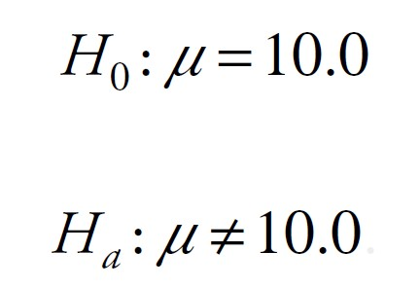
The two competing hypotheses:
The test statistics:
Ch 6: Hypothesis Testing – Testing Hypothesis for Mean – Large Sample Size

Slide 20
The rejection region:
Since 0.044 = p < a = 0.05, we reject the null hypothesis and accept the alternative.
Thus, the new drug is more effective than the old one with an error of 4.4 percent.
Ch 6: Hypothesis Testing – Testing Hypothesis for Mean – Large Sample Size

Slide 21
Comments:
The null hypothesis for this test is that the population mean is equal to a particular number.
That number thought of as the “default value,” the “status quo,” or the “best guess” value
Usually mentioned explicitly somewhere in the problem
The alternative hypothesis could actually be split into two cases:
two-tailed test where μ ≠ ${\text{m}}_{0}$
or one-tailed test where either μ > ${\text{m}}_{0}$ or μ < ${\text{m}}_{0}$
However, for simplicity we will restrict ourselves to the more conservative two-tailed case here while discussing one-tailed tests in a later section.
Ch 6: Hypothesis Testing – Testing Hypothesis for Mean – Large Sample Size

Slide 22
Comments:
Please note that even if we reject a null hypothesis and hence accept the alternative it is still possible that the null hypothesis is true.
However, the probability with which that can happen is p, which is small if we choose this answer (smaller than our predetermined comfort level a).
This error of rejecting the null hypothesis even though it is true is called a type-1 error.
In our statistical language there are two outcomes for a test: reject $H_{0}$ or inconclusive test.
For real problems, however, you should always phrase your conclusion in terms that are relevant for the particular problem and easy to understand even if you knew nothing about statistics.
Ch 6: Hypothesis Testing – Testing Hypothesis for Mean – Large Sample Size

Slide 23
Example
Bottles of ketchup are filled automatically by a machine that must be adjusted periodically to increase or decrease the average con- tent per bottle. Each bottle is supposed to contain 18 oz. It is important to detect an average content significantly above or below 18 oz so that the machine can be adjusted; too much ketchup per bottle would be unprofitable, while too little would be a poor business practice and open the company up to law suits about invalid labeling.
We select a random sample of 32 bottles filled by the machine and compute their average weight to be 18.24 with a standard deviation of 0.7334.
Should we adjust the machine?
Use a comfort level of 5 percent.
Ch 6: Hypothesis Testing – Testing Hypothesis for Mean – Large Sample Size

Slide 24
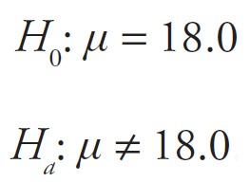
We can see right away that the average weight of our sample, being 18.24 oz, is indeed different from what it is supposed to be (18 oz)
But the question is whether the difference is statistically significant (or “large enough” so that it would be unlikely if the null hypothesis was true)
The two competing hypotheses:
Ch 6: Hypothesis Testing – Testing Hypothesis for Mean – Large Sample Size

Slide 25
The test statistics:
The rejection region:
This time we have 0.064 = p > a = 0.05 so that our test is inconclusive.
For our example, this means that we do not know conclusively if the machine works correctly or not.
In particular, we would not adjust the machine at this time.
Ch 6: Hypothesis Testing – Testing Hypothesis for Mean – Large Sample Size

Slide 26
Example
In a nutrition study, 48 calves were fed “factor X” exclusively for six weeks. The weight gain was recorded for each calf, yielding a sample mean of 22.4 lb and a standard deviation of 11.5 lb. Other nutritional supplements are known to cause an average weight gain of about 20 lb in six weeks.
Can we conclude from this evidence that, in general, a six-week diet of “factor X” will yield an average weight gain of 20 lb or more at the 1 percent level of significance?
In other words, is “factor X” feed significantly better than standard supplements?
Ch 6: Hypothesis Testing – Testing Hypothesis for Mean – Large Sample Size

Slide 27
Null hypothesis: $H_{0}$: μ = 20, that is, there is no improvement, everything is as it has always been.
Alternative hypothesis: $H_{a}$: μ ≠ 20 (we actually want to know whether “factor X” results in higher average weight gains, so that our alternative hypothesis really should be $H_{a}$: μ > 20 but that would be a one-tailed test, which we will not conduct.
Test statistics: Sample mean is 22.4, standard deviation is 11.5, and sample size is 48. That makes the z-score
Ch 6: Hypothesis Testing – Testing Hypothesis for Mean – Large Sample Size

Slide 28
We finally use Excel to compute
p = 2 * (1 - NORMSDIST(1.446)) = 1.148 or 14.8 percent
This probability is relatively large: If we reject the null hypothesis, the probability that we make a mistake is 14.8 percent.
This is larger than our comfort level of 1 percent, so our conclusion:
The test is inconclusive, which means there is not enough evidence to decide whether “factor X” feed is better (or worse) than the regular feed.
Ch 6: Hypothesis Testing – Testing Hypothesis for Mean – Large Sample Size

Slide 29
Example
A group of secondary education student teachers were given 2.5 days of training in interpersonal communication group work. The effect of such a training session on the dogmatic nature of the student teachers was measured as the difference of scores on the “Rokeach dogmatism test” given before and after the training session. The difference “post minus pre score” was recorded as follows:
−16, −5, 4, 19, −40, −16, −29, 15, −2, 0, 5, −23, −3, 16, −8, 9, −14, −33, −64, −33
Can we conclude from this evidence that the training session makes student teachers less dogmatic (at the 5 percent level of significance)?
Ch 6: Hypothesis Testing – Testing Hypothesis for Mean – Large Sample Size

Slide 30
We can easily compute (using Excel):
the sample mean: -10.9
the standard deviation: 21.33
The sample size is N = 20, which is a problem, since N should be at least 30 to use the procedure introduced earlier.
So, we need to define the procedure to test for a sample mean if the sample size is small before we can continue.
Ch 6: Hypothesis Testing – Testing Hypothesis for Mean – Large Sample Size

Slide 31
Small Sample Size (n ≤ 30)
Fix an error level you are comfortable with (as usual, something like 10 percent, 5 percent, or 1 percent is most common) and denote that “comfortable” error level by a (our level of significance). Then set up the test as follows:
Null hypothesis: $H_{0}$: μ = ${\text{m}}_{0}$ where ${\text{m}}_{0}$ is a fixed number
Alternative hypothesis: $H_{a}$: μ ≠ ${\text{m}}_{0}$
Test statistics: $t_{0}$ = $\frac{\overline{x }−{\text{m}}_{0}}{(s\text{|} \sqrt{n})}$
Rejection region:
p = 2P (t >|$t_{0}$|)= TDIST (ABS($t_{0}$),df,2)
where df = n − 1. If p < a, reject the null hypothesis; otherwise the test is inconclusive.
Ch 6: Hypothesis Testing – Testing Hypothesis for Mean – Small Sample Size
Notes:
In this section we will adjust our statistical test for the population mean to apply to small sample situations. Fortunately (sic!), this will be easy—in fact, once you understand one statistical test, additional tests are easy since they all follow a similar framework.
The only difference in performing a “small sample” statistical test for the mean as opposed to our “large sample” test is that we do not use the normal distribution as prescribed by the Central Limit theorem, but instead the more conservative t-distribution introduced earlier.

Slide 32
Example
A group of secondary education student teachers were given 2.5 days of training in interpersonal communication group work. The effect of such a training session on the dogmatic nature of the student teachers was measured as the difference of scores on the “Rokeach dogmatism test” given before and after the training session. The difference “post minus pre score” was recorded as follows:
−16, −5, 4, 19, −40, −16, −29, 15, −2, 0, 5, −23, −3, 16, −8, 9, −14, −33, −64, −33
Can we conclude from this evidence that the training session makes student teachers less dogmatic (at the 5 percent level of significance)?
Ch 6: Hypothesis Testing – Testing Hypothesis for Mean – Small Sample Size
Notes:
Note that the null and alternative hypothesis for this test are the same as before; the calculation of the test statistics is the same as well, but the result is called $t_{0}$ instead of $z_{0}$.
The final probability p, however, is computed using the t-distribution.
To see how this works, let us reconsider our last example.

Slide 33
We have already computed the mean $\overline{x }$ = −10.9 and the standard deviation s = 21.33. The sample size is N = 20, so our test goes as follows:
Null hypothesis: $H_{0}$: μ = 0
Alternative hypothesis: $H_{a}$: μ ≠ 0
Test statistics:
Rejection region: p = 2P(t > 2.285) = TDIST (2.285,20 − 1,2) = 0.034
Since 0.034 = p < a = 0.05, we reject the null hypothesis and conclude that the training indeed had an impact.
Ch 6: Hypothesis Testing – Testing Hypothesis for Mean – Small Sample Size
Notes:
To be picky, we do not want to know whether the training had an impact (μ ≠ 0) but we really want to know if the training made the student teachers less dogmatic (μ < 0). Technically this amounts to a one-tailed test, which we will cover a little later in this chapter.

Slide 34
Example
Suppose GAP, the clothing store, wants to introduce their line of clothing for women to another country. But their clothing sizes are based on the assumption that the average size of a woman is 162 cm. To determine whether they can simply ship the clothes to the new country they select five women at random in the target country and determine their heights as follows:
149, 165, 150, 158, 153
Should they adjust their line of clothing or they ship them without change?
Make sure to decide at the 0.05 level.
Ch 6: Hypothesis Testing – Testing Hypothesis for Mean – Small Sample Size

Slide 35
Null hypothesis: $H_{0}$: μ = 162
Alternative hypothesis: $H_{a}$: μ ≠ 162
Test statistics:
Rejection region: p = 2P(t > 2.37) = TDIST (2.37,5 − 1,2) = 0.077.
Since 0.077 = p > a = 0.05, the test is inconclusive.
Ch 6: Hypothesis Testing – Testing Hypothesis for Mean – Small Sample Size
Notes:
Note that our test is inconclusive, which does not mean that we accept the null hypothesis. Thus, we do not recommend anything to GAP. Using common sense, however, we could suggest that GAP conduct a new study but this time with a random sample of (much) larger size, something like 100 or more. Hopefully the new study will provide statistically significant evidence.

Slide 36
Difference of Means Test
In many medical trials, for example, subjects are randomly divided into two groups: One group receives a new drug and the second receives a placebo (sugar pill). Then a researcher measures any differences between the two groups to check the efficacy of the new medication.
While our test for a single mean used the sample size to distinguish between two slightly different procedures, a test for the difference of two means uses the variances of the two underlying populations to distinguish between two different procedures.
We use the ratio of sample variances ${s_{1}^{2}}/{s_{2}^{2}}$ to decide which case to use:
If the ratio of sample variances ${s_{1}^{2}}/{s_{2}^{2}}$ is between 0.5 and 2 we assume that the population variances are approximately equal and use the procedure for equal variances, otherwise that for unequal variances.
Ch 6: Hypothesis Testing – Difference of Means Test
Notes:
Our next test applies to differences of means. Such tests are common when you conduct a study involving two groups.

Slide 37
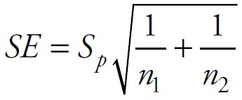
Equal Variances
Suppose that two independent samples with sizes $n_{1}$ and $n_{2}$, are selected from two populations that have approximately the same population variances.
Compute the pooled standard deviation
joint standard error
Ch 6: Hypothesis Testing – Difference of Means Test – Equal Variances

Slide 38
Equal Variances
Then a two-sample test about the difference of means goes as follows:
Null hypothesis: $H_{0}$: ${\text{m}}_{1}−$ ${\text{m}}_{2}$ = c where c is some constant
Alternative hypothesis: $H_{a}$: ${\text{m}}_{1}−$ ${\text{m}}_{2}$ ≠ c
Test statistics: $t_{0}$ = $\frac{{\overline{x }}_{1}−{\overline{x }}_{2 }−c}{SE}$, where SE is the joint standard error (see earlier)
Rejection region:
p = 2P (t >|$t_{0}$|)= TDIST (ABS($t_{0}$),df,2) with df = $n_{1}$ + $n_{2} −$ 2
If p is small, reject the null hypothesis; otherwise the test is inconclusive.
As in previous test, “p is small” means that p < a for some fixed number a, typically 0.1, 0.05, or 0.01.
Ch 6: Hypothesis Testing – Difference of Means Test – Equal Variances

Slide 39
Example
Two procedures to determine the amylase in human body fluids were studied. The “original” method is considered to be an acceptable standard method, while the “new” method uses a smaller volume of water, making it more convenient as well as more economical. Proponents of the new method claim that the amylase values obtained by the new method yields better results, on average, than the original method.
A test using the original method was conducted on 14 subjects and the test with the new method on 15 subjects, giving the data displayed in Table 6.1.
Test the claim at the 1 percent level.
Table 6.1 Data for amylase analysis example
Ch 6: Hypothesis Testing – Difference of Means Test – Equal Variances

Slide 40
Using Excel we find the means and standard deviations of the two variables as:
Note that $\frac{s_{1}^{2}}{s_{2}^{2}}= \frac{{11.932}^{2}}{{13.281}^{2}}=$0.8, which is between 0.5 and 2 so that we can indeed use the procedure for equal variances.
Ch 6: Hypothesis Testing – Difference of Means Test – Equal Variances

Slide 41
The test for the difference of means therefore:
Null hypothesis: ${\text{m}}_{1}−$ ${\text{m}}_{2}$ = 0
Alternative hypothesis: ${\text{m}}_{1}−$ ${\text{m}}_{2}$ ≠ 0
Pooled standard deviation:
Joint standard error:
Ch 6: Hypothesis Testing – Difference of Means Test – Equal Variances

Slide 42
Test statistic:
Rejection region:
p = 2P(t >|$t_{0}$|)= TDIST(2.5427,27,2) = 0.017
Since p is (just barely) larger than 0.01, our test is inconclusive at the 1 percent level.
Ch 6: Hypothesis Testing – Difference of Means Test – Equal Variances

Slide 43
This means that there is not enough evidence to conclude that the two methods of checking amylase are different.
In particular, neither method can be called better than the other.
Now it is tempting to change the value of a to 0.05, because at that level the test would be conclusive. But that is not correct.
The value of a should be chosen carefully prior to starting your experiment.
Presumably whatever reason made you decide on a 1 percent value has not changed.
Adjusting a after the fact amounts to fixing the data to support whatever conclusion you want to come out.
Ch 6: Hypothesis Testing – Difference of Means Test – Equal Variances

Slide 44
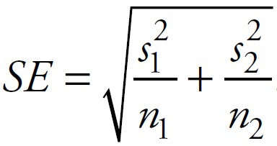
Unequal Variances
Suppose that two independent samples with sizes $n_{1}$ and $n_{2}$, selected from populations with unequal variances.
Compute the joint standard error
Ch 6: Hypothesis Testing – Difference of Means Test – Unequal Variances

Slide 45
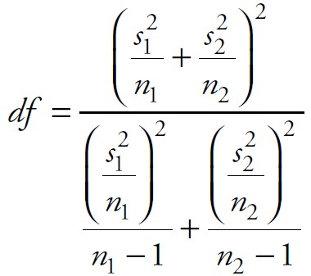
Unequal Variances
Then a two-sample test about the difference of means:
Null hypothesis: $H_{0}$: ${\text{m}}_{1}−$ ${\text{m}}_{2}$ = c where c is some constant
Alternative hypothesis: $H_{a}$: ${\text{m}}_{1}−$ ${\text{m}}_{2}$ ≠ c
Test statistics: $t_{0}$ = $\frac{{\overline{x }}_{1}−{\overline{x }}_{2 }−c}{SE}$, where SE is the standard error defined earlier
Rejection region: p = 2P(t >|$t_{0}$|)= TDIST (ABS($t_{0}$),df,2)
with degree of freedom
As usual, “p is small” means that p < a for some fixed number a, typically 0.1, 0.05, or 0.01.
(use the nearest integer). If p is small, reject the null hypothesis; otherwise the test is inconclusive
Ch 6: Hypothesis Testing – Difference of Means Test – Unequal Variances

Slide 46
Example
The data file employeenumeric-split.xls contains the salaries for the Acme Widget Company, separated by sex.
Use that data to test the hypothesis that women make at least $10,000 less on average than men at that company.
www.betterbusinessdecisions.org/data/employeenumeric-split.xls
Ch 6: Hypothesis Testing – Difference of Means Test – Unequal Variances

Slide 47
First, we need to find the mean and standard deviations for the two samples of our data.
Next, we need to decide if the variances are equal or not by checking the ratio of the sample variances:
Ch 6: Hypothesis Testing – Difference of Means Test – Unequal Variances
Notes:
Since we have the raw data we could use the appropriate test procedure from the Analysis ToolPak (which you should try as practice—see the following text), but we will first use the manual procedure outlined earlier.

Slide 48
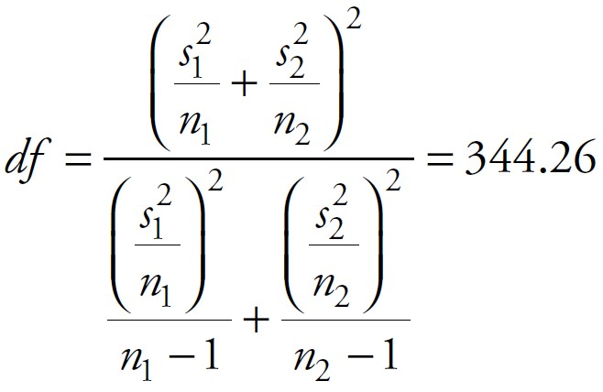
This ratio is greater than 1, so we need to use the “unequal variance” procedure. Now we can proceed with our two-sample test as usual:
Null hypothesis: $H_{0}$: ${\text{m}}_{1}−$ ${\text{m}}_{2}$ ≠ $10,000
Alternative hypothesis: $H_{a}$: ${\text{m}}_{1}−$ ${\text{m}}_{2}$ ≠ $10,000
Joint standard error:
Degree of freedom:
(closest integer) so that df = 344
Ch 6: Hypothesis Testing – Difference of Means Test – Unequal Variances

Slide 49
Test statistics:
Rejection region:
p = 2P(t > 4.103) = TDIST(4.103,344,2) = 0.00005
Since p < 0.01, we reject the null hypothesis and accept the alternative.
Ch 6: Hypothesis Testing – Difference of Means Test – Unequal Variances

Slide 50
Thus, the difference in average salary between men and women at the Acme Widget Company is at least $10,000 and we are very sure that this answer is correct (since p = 0.00005).
Note that our test actually confirms that the difference is not equal to $10,000, but looking at the actual values of the means as computed by Excel we can clearly conclude that the difference must be more than $10,000 (it is certainly not less).
In fact, a one-tailed test would be more appropriate here (see the “One-Tailed and Two-Tailed Tests” section), which would show indeed that men make at least $10,000 more than women.
Ch 6: Hypothesis Testing – Difference of Means Test – Unequal Variances

Slide 51
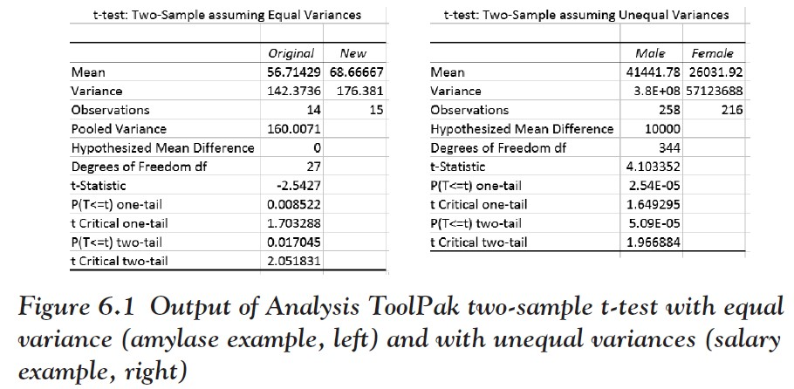
Excel output for the last two examples:
Ch 6: Hypothesis Testing – Difference of Means Test – Unequal Variances
Notes:
Excel actually provides several procedures in the Analysis ToolPak to help conduct this test, including the “t-test assuming unequal variances” and the “t-test assuming equal variances.” We leave the details to you, but the output Excel produces for the last two examples is shown in Figure 6.1.

Slide 52
Testing Hypothesis for Proportion
Null hypothesis $H_{0}$: π = $p_{0}$
Alternative hypothesis $H_{a}$: π ≠ $p_{0}$
Test statistics: $z_{0}$= $\frac{\hat{p}− p_{0}}{SE}$ ,where SE = $\sqrt{\frac{p_{0 }. (1− p_{0})}{n}}$
Rejection region: p = 2(1 – NORMIDIST(ABS($z_{0}$),0,1,true))
reject the null hypothesis if p < a
Here $\hat{p}= \frac{x}{n}$ is the ratio of the number of successes divided by the total number of trials. This procedure is valid as long as there are at least 10 successes and 10 failures in our sample.
Note that we use the standard normal distribution to compute the p-value. This is only an approximation, actually, and we could compute p exactly. However, the added accuracy is negligible, so we will not bother.
Ch 6: Hypothesis Testing – Testing Hypothesis for Proportion
Notes:
Finally, let us introduce one more test, namely, testing for a proportion. This will be useful because it works on non-numerical variables whereas our previous tests required numerical ones. Recall that a proportion p is the number of successes divided by the total number of tries in a Bernoulli trial that has only two outcomes called success or failure. Our goal is to decide what the (unknown) probability of success might be, or—to phrase it in terms appropriate for a test—whether the probability of success equals a specific value or not.

Slide 53
Example
Providing municipal services costs money; in order to cover the rising costs, a municipality could raise taxes or cut services. The town conducts a survey, asking 200 randomly selected people if taxes should go up; it turns out that 108 vote to increase taxes and 92 vote no.
If you were hired by the town as statistical consultant, how would you advise the town?
Ch 6: Hypothesis Testing – Testing Hypothesis for Proportion

Slide 54
We set up our hypothesis as follows:
Null hypothesis $H_{0}$: π = 0.5
Alternative hypothesis $H_{a}$: π ≠ 0.5
If our test lets us reject the null hypothesis we would accept the alternative where π ≠ 0.5.
But our sample ratio of 0.54 would then imply that π > 0.5 so that we could conclude that the majority of all people in the town want to see taxes raised.
The other outcome would be that the test is inconclusive so that we would not recommend any course of action to the town.
Ch 6: Hypothesis Testing – Testing Hypothesis for Proportion
Notes:
Of course at first glance it looks like the town should increase taxes, since 108 out of 200, or 54 percent, voted yes. But that is only 54 percent of the sample asked whereas we need to infer the proportion of the entire town from that.
In fact, we need to figure out whether the population proportion is 50 percent or not, based on the sample.

Slide 55
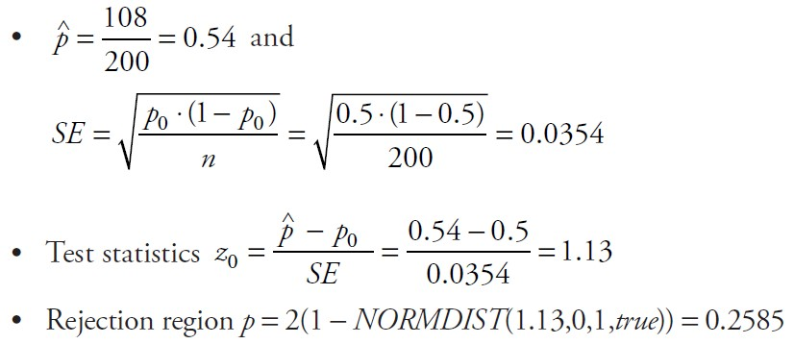
First, let us fix our level of significance a = 0.05. Then:
Since 0.2585 = p > a = 0.05, our test is inconclusive.
Thus, 108 out of a sample of 200 is not enough “yes” votes to convince us that the majority of the entire town is for raising taxes.
Of course the town could decide to raise taxes after all, but if they claimed that based on this survey the majority of people were for raising taxes, their margin of error would be 25 percent, which should be way too high to feel comfortable about.
Ch 6: Hypothesis Testing – Testing Hypothesis for Proportion
Notes:
The preceding example is interesting because at first it seems unclear what the null hypothesis should be. Other examples are more straightforward.

Slide 56
Example
The General Social Science Survey from 2008 includes data provided by a random sample of adults in the United States. You will find, among many other variables, answers to the question “Did the universe begin with a huge explosion?”
Based on that sample data, does the majority of people in the United States believe that this is false?
Use a level of significance a = 0.01.
www.betterbusinessdecisions.org/data/gss2008-short-2.xls
Ch 6: Hypothesis Testing – Testing Hypothesis for Proportion

Slide 57
After loading that data file you will find the variable in column AJ.
As we learned earlier, a pivot table can be used to find the ratio of true/false answers for this survey.
It turns out that 606 out of 1,088 subjects responded negatively, while 482 agreed.
The example clearly asked whether π = 0.5, so setting up this test should be straightforward.
We defined “success” if someone answered “no” to the question of whether the universe began with a huge explosion.
Ch 6: Hypothesis Testing – Testing Hypothesis for Proportion

Slide 58
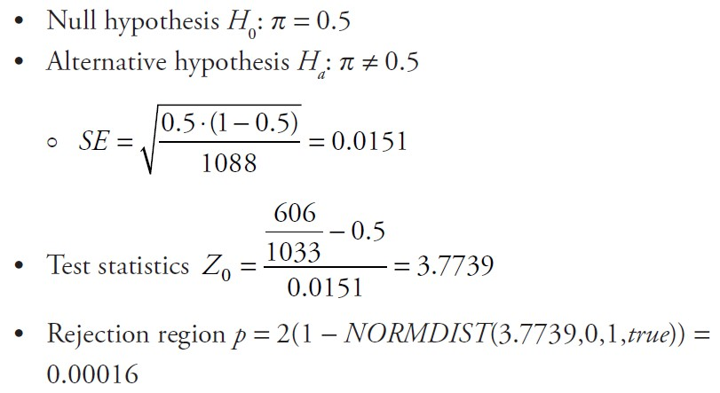
Then our test works as follows:
Since 0.00016 = p < a = 0.01, our test is conclusive.
Therefore, we reject the null hypothesis and accept the alternative.
In words this means that over 50 percent of the U.S. population does not believe that the universe started with a huge explosion.
Ch 6: Hypothesis Testing – Testing Hypothesis for Proportion
Notes:
Note: It is generally accepted today that the universe did start with the “Big Bang” (a huge explosion) some 13.798 ± 0.037 billion years ago (according to Wikipedia). Note that the age of the universe is an estimate just like we have learned in Chapter 5 but without mentioning which confidence interval this represents.

Slide 59
Example
For each of the following situations, determine the null and alternative hypotheses that best reflect the question:
Do bottles of ketchup contain less than the indicated weight of 16 oz?
Does the new feed for cows result in higher weight gain than the average of 100 lb per week when using standard feeds?
Is the effect of a new hypertension drug different from that of the traditional drug?
Ch 6: Hypothesis Testing – One-Tailed and Two-Tailed Tests
Notes:
All of our tests so far tested whether a parameter was equal to a fixed value or not. In many cases, however, we are interested more specifically if the parameter is bigger than a fixed value, or perhaps smaller, not just unequal.

Slide 60
We want to test for the mean weight of ketchup.
Let x be the weight of the contents of a ketchup bottle and μ be the (unknown) population average. Then:
We know that old feed for cows results in a weight gain of 100 lb per week on average.
Let x be the weight gain for cows getting the new feed and μ be the population average. Then:
Hypertension drugs are supposed to lower blood pressure.
If ${\text{m}}_{1}$denotes the average blood pressure of patients on the new drug and ${\text{m}}_{2}$ that of patients on the traditional drug, we want to test:
$H_{0}$: μ = 16
$H_{a}$: μ < 16
$H_{0}$: μ = 100
$H_{a}$: μ > 100
$H_{0}$: ${\text{m}}_{1}$= ${\text{m}}_{2}$
$H_{a}$: ${\text{m}}_{1}≠$ ${\text{m}}_{2}$
Ch 6: Hypothesis Testing – One-Tailed and Two-Tailed Tests

Slide 61
Examples 1 and 2 are called one-tailed tests, whereas Example 3 is a two-tailed test.
A two-tailed test at a level of significance a allocates half of that alpha to testing the statistical significance in one direction and half of the alpha to testing statistical significance in the other direction.
A one-tailed test, on the other hand, concentrates the entire alpha on one of the tails of the distribution.
A one-tailed test has a slightly different rejection region.
Ch 6: Hypothesis Testing – One-Tailed and Two-Tailed Tests

Slide 62
One-tailed test for the mean (large sample size):
One-tailed test for the mean (small sample size):
One-tailed test for the difference of two means—compute df as usual:
Ch 6: Hypothesis Testing – One-Tailed and Two-Tailed Tests

Slide 63
Example
We suspect that bottles of ketchup contain less than the indicated weight of 16 oz.
We collect a sample of 100 bottles and find that the sample mean is 15.5 oz with s = 2.6 oz.
Decide at the a = 0.05 level.
Ch 6: Hypothesis Testing – One-Tailed and Two-Tailed Tests

Slide 64
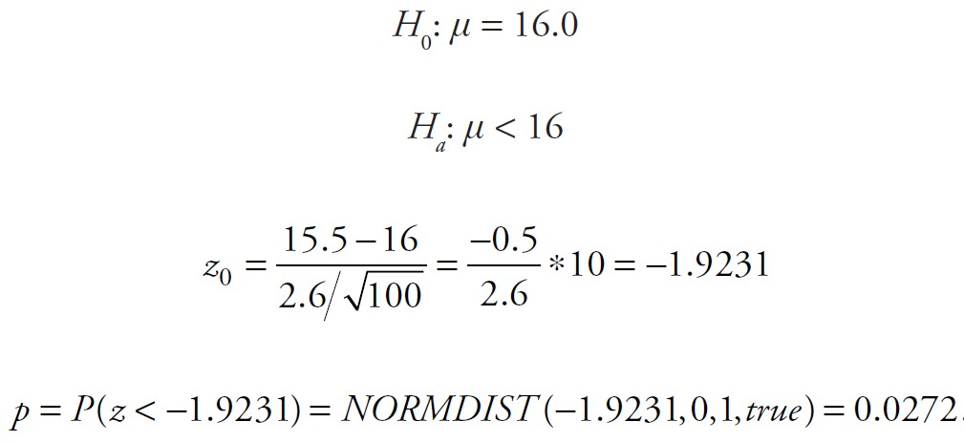
This is a one-tailed test:
Thus, since p = 0.0272 < a = 0.05, we reject the null hypothesis and thus we think that the bottles indeed contain too little content.
Ch 6: Hypothesis Testing – One-Tailed and Two-Tailed Tests

Slide 65
Note: Had we used a two-tailed test we would have found that p = 2 * 0.0272 = 0.0544 > a = 0.05, so that a two-tailed test would come out inconclusive.
This is no coincidence: A one-tailed test is more powerful than a two-tailed test; it is possible that a two-tailed test is inconclusive but the corresponding one-tailed test results in rejecting the null hypothesis.
On the other hand, if a one-tailed test is inconclusive then the corresponding two-tailed test will also be inconclusive.
Thus, if we only consider two-tailed tests we might decide that a test is inconclusive when it actually might be significant (as a one-tailed test) but we will never call a test significant when in fact it is not.
Ch 6: Hypothesis Testing – One-Tailed and Two-Tailed Tests

Slide 66
Note: If we conduct a one-tailed test $H_{a}$: μ < ${\text{m}}_{0}$ and the sample mean comes out bigger than ${\text{m}}_{0}$, then the one-tailed test will always be inconclusive.
That makes sense: If we suspect a population mean to be less than, say, 10, but our sample mean comes out bigger than 10, this can never support the alternative hypothesis. Thus, the test is inconclusive.
Mathematically we have that if $\overline{x }$>10 then $z_{0}$> 0 so that p = NORMDIST($z_{0}$,0,1,true) > 0.5 for $z_{0}$ > 0.
A similar argument applies if we test the alternative hypothesis $H_{a}$: μ > ${\text{m}}_{0}$and the sample mean $\overline{x }<{\text{m}}_{0}$ : this test, too, is inconclusive.
Ch 6: Hypothesis Testing – One-Tailed and Two-Tailed Tests

Slide 67
While confidence intervals and hypothesis testing are used for different purposes, they are related.
For example, to decide whether a population mean equals a certain value ${\text{m}}_{0}$ you would naturally conduct a test for a mean.
However, you could also compute a confidence interval as long as you interpret the answer properly:
If a 95 percent confidence interval about the mean includes the number ${\text{m}}_{0}$, the test whether the mean equals ${\text{m}}_{0}$ would be inconclusive at the a = 0.05 level.
If a 95 percent confidence interval about the mean excludes the number ${\text{m}}_{0}$, we would reject the null hypothesis that μ = ${\text{m}}_{0}$ and accept the alternative that μ ≠ ${\text{m}}_{0}$ at the a = 0.05 level.
Ch 6: Hypothesis Testing – Relationship Between Confidence Intervals and Hypothesis Testing

Slide 68
Example
To equip soldiers with properly fitting helmets it is important to know the average head size of all soldiers. A study selected 80 soldiers at random and measured their head size. It turns out that the sample has an average head size of 56 cm with a standard deviation of 1.36 cm.
Find a 95 percent confidence interval for the population mean and use it to decide if the population mean could be 56.3.
Ch 6: Hypothesis Testing – Relationship Between Confidence Intervals and Hypothesis Testing

Slide 69
To compute a 95 percent confidence interval (for large N), we need to find
so that the 95 percent confidence interval goes from 55.702 to 56.298
This interval does not include the hypothesized mean of 56.3 so that according to our discussion the population mean could not be 56.3 (within our alpha level of 0.05).
Ch 6: Hypothesis Testing – Relationship Between Confidence Intervals and Hypothesis Testing

Slide 70
Let us conduct a proper test to see if we get the same answer.
Our null hypothesis would be $H_{0}$: μ = 56.3 with the alternative $H_{a}$: μ ≠ 56.3.
We compute the z-score
Finally we compute the value of
p = 2 * (1 − NORMDIST(1.973,0,1,true)) = 0.485
This is smaller than alpha so that we indeed reject the null hypothesis and conclude that the population mean indeed cannot be equal to 56.3.
Ch 6: Hypothesis Testing – Relationship Between Confidence Intervals and Hypothesis Testing
Notes:
Note that the hypothesized mean of 56.3 is barely outside the 95 percent confidence interval. That corresponds to the p-value being just smaller than 0.05. If we checked for a number well outside the 95 percent confidence interval, the corresponding p-value would be much smaller than 0.05.

Slide 71
Summary
Hypothesis testing lets you decide which of two mutually exclusive situations is true and provides an error estimate for your answer. Each test has four components:
a null hypothesis $H_{0}$
an alternative hypothesis $H_{a}$
test statistics
a rejection region where you compute a probability p and decide to reject $H_{0}$ (and accept $H_{a}$) if p < a; otherwise the test is inconclusive
The number a is called level of significance and is typically 0.1, 0.05, or 0.01.
Ch 6: Hypothesis Testing – Summary

Slide 72
Test for a mean:
$H_{0}$: μ = ${\text{m}}_{0}$
$H_{a}$: μ ≠ ${\text{m}}_{0}$
Test statistics: $z_{0}$ = $\frac{\overline{x }−{\text{m}}_{0}}{(s\text{|} \sqrt{n})}$
Probability
For large samples (n>30):
p = 2(1 – NORMDIST(ABS($z_{0}$),0,1,true))
For small samples (n≤30)
p = TDIST(ABS($t_{0}$),N –1,2)
Ch 6: Hypothesis Testing – Summary

Slide 73
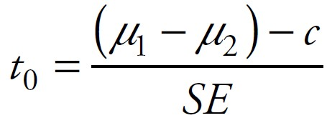
Test for a difference of means (equal variances):
$H_{0}$: ${\text{m}}_{1}−$ ${\text{m}}_{2}=c$
$H_{a}$: ${\text{m}}_{1}−$ ${\text{m}}_{2} ≠ c$
Test statistics:
Probability p = TDIST(ABS($t_{0}$),$n_{1}+n_{2}$ – 2,2)
Ch 6: Hypothesis Testing – Summary

Slide 74
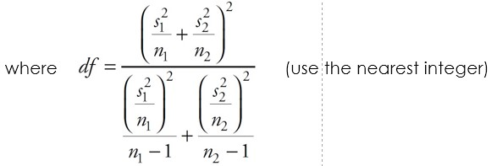
Test for a difference of means (unequal variances):
$H_{0}$: ${\text{m}}_{1}−$ ${\text{m}}_{2}=c$
$H_{a}$: ${\text{m}}_{1}−$ ${\text{m}}_{2} ≠ c$
Test statistics:
Probability p = TDIST(ABS($t_{0}$),df,2)
Ch 6: Hypothesis Testing – Summary

Slide 75
Test for proportion:
$H_{0}$: p = $p_{0}$
$H_{a}$: p ≠ $p_{0}$
Test statistics:
p = 2(1 – NORMIDIST(ABS($z_{0}$),0,1,true))
Ch 6: Hypothesis Testing – Summary

Slide 76
Excel Demonstration
Company P, the large manufacturer of paper products, has the business objective of developing an improved process for fulfilling orders during the 12 p.m. to 1 p.m. lunch period. The management decides to first study the fulfillment and delivery time in the current process in the plant. The fulfillment time is defined as the number of minutes that elapses from when the order enters the plant until the product is packed and ready to ship. The data collected from a random sample are presented from two assembly lines within the company.
Assuming that the population variances from both lines are unequal, is there evidence of a difference in the mean fulfillment time between the two lines, using alpha = 0.05?
Ch 6: Hypothesis Testing – Excel Demonstration

Slide 77
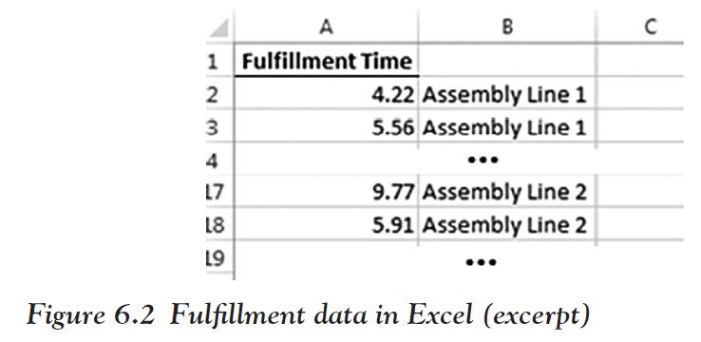
Step 1:
Enter the fulfillment times into Excel in Column A and create a corresponding identifying label in Column B (see Figure 6.2):
Assembly Line 1: 4.22, 5.56, 3.01, 5.14, 4.78, 2.35, 3.53, 3.21, 4.49, 6.11, 0.39, 5.13, 6.47, 6.20, 3.80
Assembly Line 2: 9.77, 5.91, 8.01, 5.78, 8.72, 3.81, 8.02, 8.36, 10.48, 6.69, 5.67, 4.09, 6.18, 9.90, 5.48
Ch 6: Hypothesis Testing – Excel Demonstration

Slide 78
Step 2:
Click on “Data,” then “Data Analysis,” and choose “t-Test: Two-Sample Assuming Unequal Variances.”
Note: In this example we were told the variances are unequal, which is why we chose the tool we did.
If you are not told, you must first check whether the variances are equal in both groups, which determines the type of t-test to perform (one that assumes equal variances or one that does not make that assumption).
A conservative approach is to always assume unequal variances.
Ch 6: Hypothesis Testing – Excel Demonstration

Slide 79
Step 3:
For “Variable Range 1,” enter or select the range of numbers for Assembly Line 1 in column A.
For “Variance Range 2,” enter or select the range of numbers for Assembly Line 2, column A.
Ch 6: Hypothesis Testing – Excel Demonstration

Slide 80
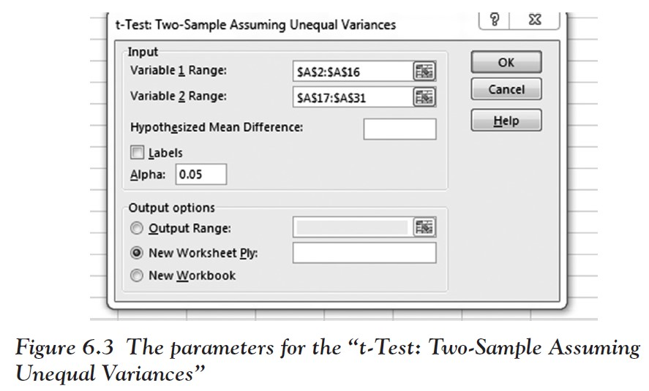
Step 4:
Since we did not use labels in the first row, we do not need to check the “Labels” box.
The alpha level is set by default to 0.05, which is what we wanted to use.
Compare with Figure 6.3; then Click OK.
Ch 6: Hypothesis Testing – Excel Demonstration

Slide 81
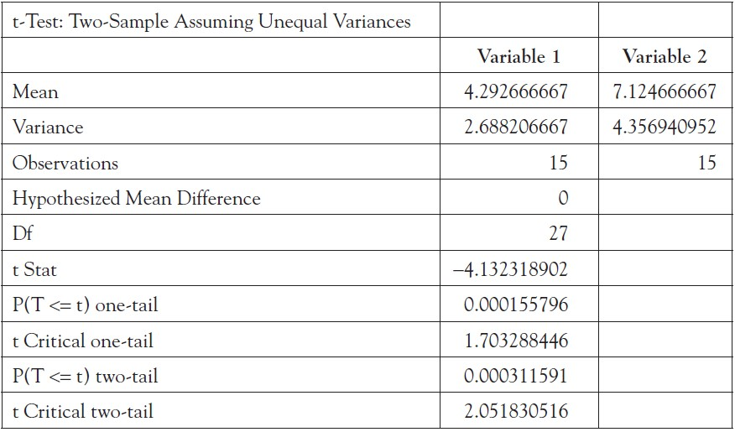
The procedure should produce the following output.
Ch 6: Hypothesis Testing – Excel Demonstration

Slide 82
This relates to our problem as follows.
Null hypothesis: There is no difference (the two means are equal) in fulfillment time between Assembly Line 1 and Assembly Line 2.
Alternative hypothesis: There is a difference (the two means are not equal) in fulfillment time between Assembly Line 1 and Assembly Line 2.
Results: We have a two-tailed p-value of 0.0003. This is less than our alpha value, so we reject the null hypothesis and conclude that there is difference (the two means are not equal) in fulfillment time between Assembly Line 1 and Assembly Line 2.
Ch 6: Hypothesis Testing – Excel Demonstration

Slide 83
Even though we used a two-tailed test, that is, we do not care which mean is larger, it is clear that the means are different because Assembly Line 1 has a smaller mean than line 2.
Since Company P wishes to reduce fulfillment times within their manufacturing plant, the management should try to identify why there is a difference and consider implementing the work practices of Assembly Line 1 across all assembly lines as best practice.
Ch 6: Hypothesis Testing – Excel Demonstration

