Slide 1
Using Statistics for Better Business Decisions
Justin Bateh and Bert G. Wachsmuth
Copyright © Justin Bateh and Bert G. Wachsmuth, 2016. All rights reserved.

Slide 2
Chapter 5 Estimation
Using Statistics for Better Business Decisions
Copyright © Justin Bateh and Bert G. Wachsmuth, 2016. All rights reserved.

Slide 3
Learning Objectives
Construct and interpret confidence interval estimates for the mean and the proportion
Determine the sample size necessary to develop a confidence interval estimate for the mean or proportion
Use confidence interval estimates in solving business problems
Ch 5: Estimation – Learning Objectives

Slide 4
Example
Consider the following data set for approximately 400 cars, assumed to be collected at random.
We would like to make predictions about all automobiles, based on that random sample.
In particular, the data set lists miles per gallon, engine size, and weight of 400 cars, but we would like to know the average miles per gallon, engine size, and weight of all cars, based on this sample.
www.betterbusinessdecisions.org/data/cars.xls
Ch 5: Estimation – Confidence Intervals for Means

Slide 5
It is of course simple to compute the mean of the various variables of the sample, starting with gas mileage.
We find that:
sample mean gas mileage is $\overline{x}$ = 23.5 miles per gallon (mpg)
sample standard deviation s = 7.82 mpg
sample size n=398
We need to know how well this sample mean $\overline{x}$ predicts the actual and unknown population mean μ.
Our best guess is clearly that the average mpg for all cars is 23.5 mpg—it is after all pretty much the only number we have—but how good is that estimate?
Ch 5: Estimation – Confidence Intervals for Means

Slide 6
In fact, we know more than just the sample mean:
We also know that all sample means are distributed normally, according to the Central Limit Theorem
That the distribution of all sample means (of which ours is just one) is normal with the same mean as the population mean and a standard deviation of ${\text{7.82} }/{\sqrt{398}}$ = 0.3920
Ch 5: Estimation – Confidence Intervals for Means

Slide 7
Let us say we want to estimate a (unknown) population mean so that we are, say, 95 percent certain that the estimate is correct (or 90 percent, or 99 percent, or any other predetermined notion of certainty we might want to have).
In other words, we need to compute a lower limit a and an upper limit b in such a way as to be 95 percent sure that our (unknown) population mean is between a and b.
Ch 5: Estimation – Confidence Intervals for Means

Slide 8
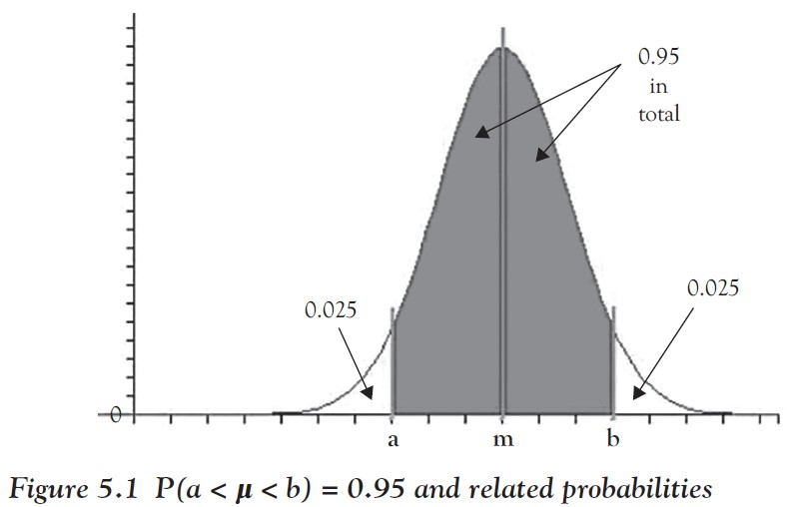
That interval (a, b) is known as a 95 percent confidence interval for the unknown mean.
Using standard probability notation we can rephrase this:
We want to find a and b so that P(a < μ < b) = 0.95
Ch 5: Estimation – Confidence Intervals for Means

Slide 9
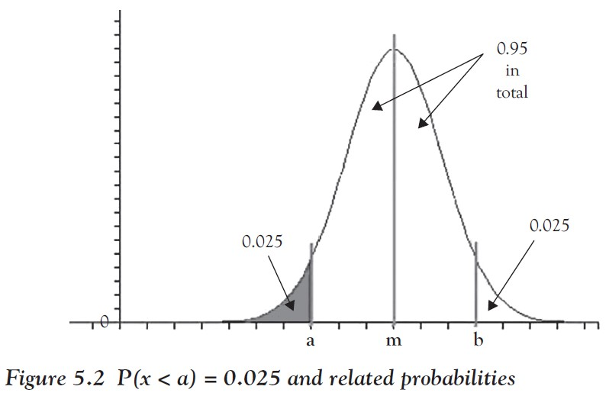
Using symmetry and focusing on the part of the distribution that we can compute with Excel, this is equivalent to finding a value of a such that P(x < a) = 0.025, since P(x < a) + P(a < x < b) + P(x > b)=1 and P(x < a)= P(x > b).
Ch 5: Estimation – Confidence Intervals for Means

Slide 10
But that is an inverse normal problem as described in Chapter 4 and the Excel function NORMINV will come to the rescue:
a = NORMINV(0.025, 23.5, 0.3290) = 22.8552
Similarly, to find b such that P(x > b)= 0.025 implies that
b = NORMINV(0.975, 23.5, 0.3290) = 24.1448
Thus, we conclude that the unknown population mean is between 22.8551 and 24.1448 with 95 percent certainty.
Alternatively, we say that the 95 percent confidence interval for the average gas mileage of all cars is (22.8551, 24.1448).
Ch 5: Estimation – Confidence Intervals for Means

Slide 11
Example
Again using our data on cars, as earlier, find the 95 percent confidence interval for the engine size of all cars.
We compute the sample mean to be 193 ${in.}^{3}$ with a standard deviation of 104.55 ${in.}^{3}$ and the sample size n = 398.
To find a 95 percent confidence interval, we need to find a such that P(x < a) = 0.025 and b such that P(x > b) = 0.025, assuming that x is N(193,104.55/$\sqrt{398}$)
Thus, since 104.55/$\sqrt{398}$ = 5.2406
a = NORMINV(0.025,193,5.2406) = 182.7286
b = NORMINV(0.975,193,5.2406) = 203.2714
Ch 5: Estimation – Confidence Intervals for Means

Slide 12
Therefore, our 95 percent confidence interval is (182.73, 203.27)
In other words, we are 95 percent certain that the unknown population mean (in this case the size of the engines of all cars) is:
between 182.73 and 203.2
with the mean 193 right in the middle
Ch 5: Estimation – Confidence Intervals for Means
Notes:
Note that the preceding discussion is based on the Central Limit Theorem.
It lets us use a normal distribution for the sample means even if the underlying distribution of the original data is unknown.
However, that approximation works best for large sample sizes n, so for small n we need to employ a slightly different procedure.
Thus, we will summarize our procedure for finding a confidence interval for a population mean, depending on the sample size n.

Slide 13
Confidence Interval for Mean, n > 30 (with Excel)
Suppose we have selected a random sample with size n > 30 and with sample mean m and sample standard deviation s. Then the p% confidence interval for the unknown population mean μ is the interval (a, b), where
a = NORMINV((1 − p)/2, m, s/$\sqrt{N}$)
b = NORMINV((1 + p)/2, m, s/$\sqrt{n}$)
Note: The sample mean m will always be half way between a and b, that is (a + b)/2 = m
You could use this relationship to quickly check your calculations.
Ch 5: Estimation – Large Sample Size
Notes:
Here we will summarize the procedure to find a confidence interval for a large sample size n. In fact, we will consider n to be large if n > 30.

Slide 14
Example
We want to know the average weight of cheese that comes in 8 oz packages.
We select a random sample of 100 packages, weigh them, and find that the sample mean is 7.8 oz with a standard deviation of 0.8 oz.
Estimate the average weight of all 8 oz packages, using a 95 percent confidence interval.
Ch 5: Estimation – Large Sample Size

Slide 15
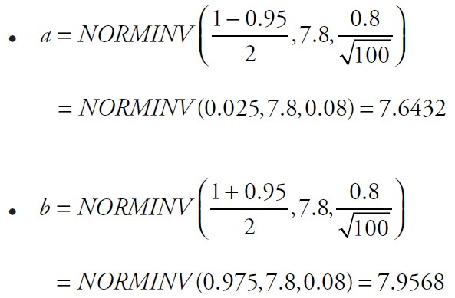
We have N = 100 > 30, so our preceding procedure for a large sample size is valid.
Thus, we find:
Note that:
so that our calculations check out
We have found that the average weight of all 8 oz packages of cheese is between 7.6432 oz and 7.9568 oz.
We are 95 percent certain of this estimate.
Ch 5: Estimation – Large Sample Size

Slide 16
Incidentally, this would mean that it is likely that these 8 oz packages of cheese are mislabeled!
They should of course contain 8 oz of cheese on average, but we found that the (unknown) average is less than 7.9568 with 95 percent certainty.
In other words, there is a small chance that the average weight of all cheeses is indeed 8 oz, but that chance is less than 5 percent.
Thus, we are relatively certain that the cheese manufacturer is indeed mislabeling their cheese.
By the way, do you think a 99 percent confidence interval would be wider or narrower than the 95 percent interval (7.6432, 7.9568)?
Ch 5: Estimation – Large Sample Size
Notes:
This kind of argument, in fact, will be formalized in the next chapter on hypothesis testing. For now we will be content with obtaining estimates together with their certainty.
By the way, do you think a 99 percent confidence interval would be wider or narrower than the 95 percent interval (7.6432, 7.9568)? You will find the answer later in this section but you should try to think about it already.

Slide 17
According to our preceding summary, a standard normal distribution has a 95 percent confidence interval (a, b) where
a = NORMINV(0.025, 0, 1) = -1.96
b = NORMINV(0.975, 0, 1) = 1.96
Thus, if we start with a normal distribution with mean m and standard deviation s, then (x - m)/s is standard normal and has a 95 percent confidence interval (-1.96, 1.96).
In other words, the confidence interval goes from (x - m)/s = -1.96 to (x - m)/s = 1.96, or equivalently, solving for x, from x = m -1.96 s to x = m + 1.96 s.
Thus, the 95 percent confidence interval for x is (m - 1.96 s, m + 1.96 s).
Ch 5: Estimation – Large Sample Size
Notes:
The preceding summary works well but it relies on Excel.
We can, however, use the z-score introduced in “The Normal Distribution” section to compute some confidence intervals without resorting to Excel at all.

Slide 18
Now we can finish up this discussion by resorting to the Central Limit Theorem:
If x has a distribution with mean m and standard deviation s then the sample means are normal with mean m and standard deviation s| $\sqrt{N}$.
But then the sample means have a 95 percent confidence interval from m – 19.6 s| $\sqrt{N}$ to m + 19.6 s| $\sqrt{N}$
Putting everything together, we can summarize an alternative method of computing confidence intervals, at least for the ones most commonly used.
Ch 5: Estimation – Large Sample Size
Notes:
The preceding summary works well but it relies on Excel.
We can, however, use the z-score introduced in “The Normal Distribution” section to compute some confidence intervals without resorting to Excel at all.

Slide 19
Confidence Interval for Mean, N > 30 (Alternate Version):
Suppose we have selected a random sample with size N > 30 and with sample mean m and sample standard deviation s. Then:
A 90 percent confidence interval goes from m – 1.645 ⋅ $\frac{s}{\sqrt{N}}$ to m + 1.645 ⋅ $\frac{s}{\sqrt{N}}$
A 95 percent confidence interval goes from m – 1.96 ⋅ $\frac{s}{\sqrt{N}}$ to m + 1.96 ⋅ $\frac{s}{\sqrt{N}}$
A 99 percent confidence interval goes from m – 2.58 ⋅ $\frac{s}{\sqrt{N}}$ to m + 2.58 ⋅ $\frac{s}{\sqrt{N}}$
Each of the intervals is centered at the mean m. The term $s/\sqrt{N}$ is known as the standard error.
Ch 5: Estimation – Large Sample Size

Slide 20
Note: As you could have (hopefully) guessed from our preceding discussion, the 90 percent and 99 percent intervals use the constants NORMINV(0.05, 0, 1) = -1.645 and NORMINV(0.005, 0, 1)= -2.58, respectively.
The improvement of this alternate version is based on the fact that you do not need Excel to compute any of these constants, a simple, plain calculator would do just fine here (unless you want to find an interval different from 90 percent, 95 percent, or 99 percent).
Ch 5: Estimation – Large Sample Size

Slide 21
Example
In an earlier example we analyzed the gasoline efficiency of cars. Recall that we looked at a sample of size N = 398 with m = 23.5 and s = 7.82.
Find a 90 percent, 95 percent, and 99 percent confidence interval for the average mpg of all cars.
Ch 5: Estimation – Large Sample Size

Slide 22
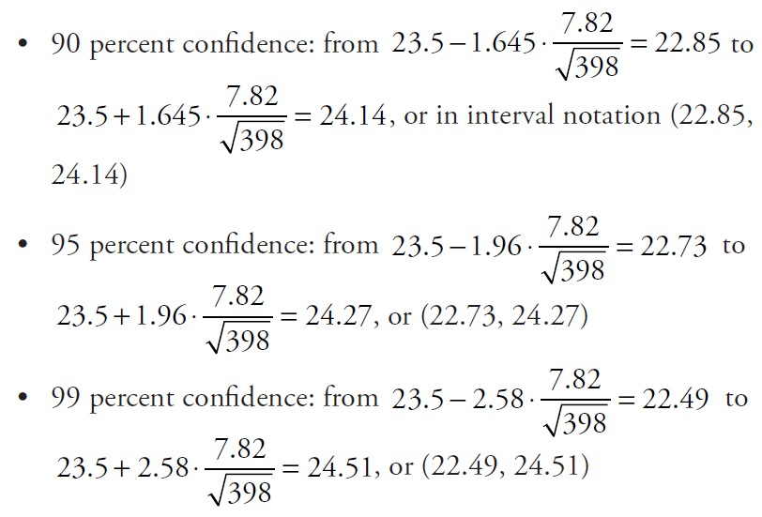
Using our alternate version the problem is pretty easy:
Ch 5: Estimation – Large Sample Size

Slide 23
Thus, we are 90 percent certain that the average mpg for all cars is between 22.85 and 24.14.
We are 95 percent certain that it is between 22.73 and 24.27.
We are 99 percent certain it is between 22.49 and 24.51.
Usually you only need to compute one of these intervals, depending on your preferred level of certainty.
There is a price to pay, though: the more certain you want to be, the bigger your interval will turn out.
Eventually, a 100 percent confidence interval would be (−∞, +∞): you are clearly 100 percent certain that the unknown population mean is in that interval (after all, any number is) but that answer, while correct, does not help at all.
Ch 5: Estimation – Large Sample Size

Slide 24
Confidence Interval for Mean, N ≤ 30 (Alternate Version):
Suppose we have selected a random sample with size N ≤ 30 and with sample mean m and sample standard deviation s.
Compute the number $t_{p}$= TINV(1 − p, N − 1) where
TINV is inverse of the t-distribution with degrees of freedom df = N − 1
p is the confidence interval to compute
Then:
The p% confidence interval goes from m – $t_{b}$ ⋅ $\frac{s}{\sqrt{N}}$ to m + $t_{b}$ ⋅ $\frac{s}{\sqrt{N}}$
Ch 5: Estimation – Small Sample Size
Notes:
As we mentioned, the derivation of the formulas for confidence intervals uses the Central Limit Theorem, which works better for larger values of N (the sample size).
For N > 30 we declare the sample size big enough but for smaller N we need to be more careful. In this case the method is based on the Student’s t-distribution, but is otherwise similar to before.
Since all t-distributions have a mean of zero, we cannot generalize our first procedure to find confidence intervals.
However, the alternate method works fine.

Slide 25
This is similar to the alternate method for large N, but the multiplier $t_{p}$ depends not only on which percentage interval we want to find but also on the sample size N.
It turns out, however, that the multiplier $t_{p}$ is always greater than the corresponding multiplier $z_{p}$ for large N
e.g. $z_{p}$ = 1.96 for a 95 percent confidence interval
so that a confidence interval using the small sample size procedure is always bigger than the one using the large sample size procedure
Ch 5: Estimation – Small Sample Size

Slide 26
Example
Suppose you want to measure the efficacy of a new blood pressure drug. Since trials involving human beings are expensive, you test the new drug on only 10 randomly selected patients.
You find that the average decrease of blood pressure in the group tested was 15 mmHg with a standard deviation of 2 mmHg.
Since we are dealing with medication given to humans, we want to be very sure about my results, so we want to know a 99 percent confidence interval.
Ch 5: Estimation – Small Sample Size

Slide 27
The sample size is N = 10, which is considered small, so that the “small size” procedure applies.
We need to find $t_{0.99}$ using N − 1 = 9 as degrees of freedom: $t_{0.99}$ = TINV(0.01,9) = 3.2498
Thus, our 99 percent confidence interval goes from
m – $t_{p}$ $\frac{s}{\sqrt{N}}$ = 15 − 3.2498 ⋅ $\frac{2.1}{\sqrt{10}}$ = 12.84 to m + $t_{p}$ $\frac{s}{\sqrt{N}}$ = 15 + 3.2498 ⋅ $\frac{2.1}{\sqrt{10}}$ = 17.16
or in interval notation (12.84, 17.16)
Ch 5: Estimation – Small Sample Size

Slide 28
Example
Consider the following data set for approximately 400 cars that we analyzed before.
Find 95 percent confidence intervals for the average miles per gallon, engine size, and weight of cars using this data.
www.betterbusinessdecisions.org/data/cars.xls
Ch 5: Estimation – Using Excel to Compute Confidence Intervals
Notes:
We have used Excel to find various confidence intervals using the mean m and standard deviation s of a data set.
This works fine even if we do not have access to the entire data, as long as we know N, m, and s.
If we do know the complete data set, Excel offers yet another method to compute confidence intervals and a host of other parameters all at once and for several variables simultaneously.

Slide 29
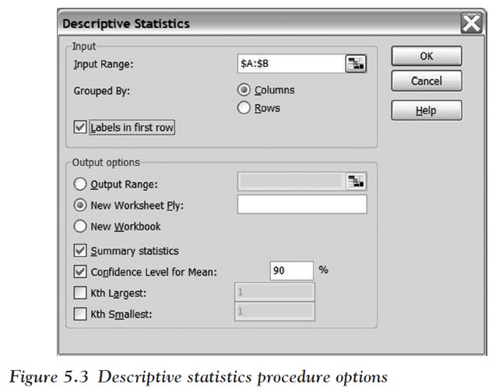
We will use the “Descriptive Statistics” tool of Excel’s Analysis Tool- Pak.
Load the data set specified
Choose “Data Analysis …” from the “Data” ribbon
Select “Descriptive Statistics” from the choice of available procedures
Ch 5: Estimation – Using Excel to Compute Confidence Intervals

Slide 30
Select as input range the first few columns, including “Miles per Gallon,” “Engine Size,” “Horse Powers,” and “Weight in Pounds”
Make sure to check the “Labels in First Row” box, the “Summary Statistics” box, and the “Confidence Level for Mean”
Specify the level of confidence for the “Confidence Level for Mean”—enter 90 percent
Click “Okay”
Ch 5: Estimation – Using Excel to Compute Confidence Intervals

Slide 31
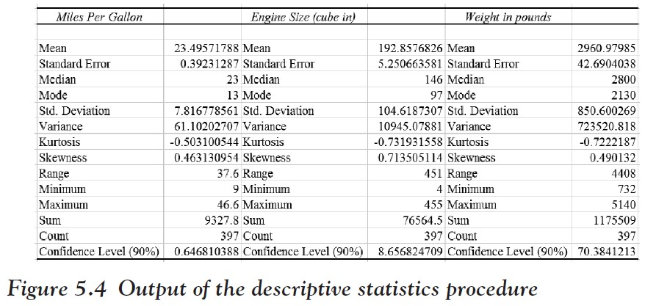
You should see a number of parameters for our data set, including the familiar mean, median, variance, and standard deviation as well as our new descriptors standard error and confidence level (90 percent).
Ch 5: Estimation – Using Excel to Compute Confidence Intervals

Slide 32
To find the actual confidence intervals in the form we are used to, we need to add/subtract the Confidence Level to/from the Mean. In our case we have:
90 percent confidence interval of average miles per gallon: from 23.4957 − 0.6468 = 22.8489 to 23.4957 + 0.6468 = 24.1425
90 percent confidence interval of average engine size: from 192.8577 − 8.6568 = 184.2008 to 192.8577 + 8.6568 = 201.5145073
90 percent confidence interval of average weight (in pounds) from 2960.9799 − 70.3841 = 2890.5957 to 2960.9798 + 70.3842 = 3031.3640
Ch 5: Estimation – Using Excel to Compute Confidence Intervals

Slide 33
Example
Suppose we compute, for the same sample data, both a 90 percent and a 99 percent confidence interval. Which one is larger?
To answer this question, let us first look at an example:
We compute both a 90 percent and a 99 percent confidence interval for the “Horse Power” in the preceding data set about cars, using Excel.
Ch 5: Estimation – Comparing Confidence Intervals

Slide 34
The procedure of computing the numbers is similar to the one earlier; here are the answers:
The sample mean for the “Horse Power” is 104.27
The 90 percent confidence level results in 3.19
so that the 90 percent confidence interval goes from 104.27 - 3.19 to 104.27 + 3.19, or from 101.08 to 107.46
The 99 percent confidence level results in 5.01
so that the 99 percent confidence interval goes from 104.27 - 5.01 to 104.27 + 5.01, or from 99.26 to 109.28
Ch 5: Estimation – Comparing Confidence Intervals

Slide 35
Since the 99 percent interval (99.26, 109.28) includes the 90 percent interval (101.08, 107.46), we conjecture that in general a 99 percent confidence interval is always larger than a 90 percent confidence interval.
That makes sense: If we want to be more certain that we have captured the true (unknown) population mean correctly, we need to make our interval larger.
The larger the interval, the better our chance of capturing the unknown population mean.
Hence, a 99 percent confidence interval must be wider than a 90 percent confidence interval.
Ch 5: Estimation – Comparing Confidence Intervals

Slide 36
Another way to argue is that every 99 percent interval is automatically also a 90 percent interval, because if we are 99 percent certain to include the mean, we are in particular 90 percent certain to include it.
The other way around is not true.
Thus, the 99 percent interval must contain the 90 percent interval and must therefore be wider.
Last, we want to compare the two methods for computing confidence intervals: the one based on a normal distribution (for N > 30) and the other one based on the t-distribution (for N ≤ 30).
Ch 5: Estimation – Comparing Confidence Intervals

Slide 37
Example
A crime scene investigator finds an unknown liquid at a crime scene. To help identify it, she decides to determine its boiling point. Heating up the entire liquid would destroy the evidence, so instead she takes nine small samples and determines their boiling points. It turns out that the sample mean is 86.5°C with a sample standard deviation of 0.6°C.
Find a 95 percent confidence interval for the boiling point of the substance, using the small and the large sample size method (even though only one of the methods is appropriate, technically speaking).
Ch 5: Estimation – Comparing Confidence Intervals
Notes:
First, we will consider an example.

Slide 38
Small sample method:
We need to find the multiplier $t_{0.95}$ = TINV(0.05,8) = 2.3060 and the standard error $\frac{s}{\sqrt{N}}$ = $\frac{0.6}{\sqrt{9}}$ = 0.2.
Then the 95 percent confidence interval goes from 86.5 – 2.306 ⋅ 0.2 = 86.0388 to 86.5 + 2.306 ⋅ 0.2 = 86.9612.
Ch 5: Estimation – Comparing Confidence Intervals

Slide 39
Large sample method:
The multiplier for a 95 percent confidence interval is always 1.96 while the standard error is the same as before.
Thus, the interval goes from 86.5 – 1.96 ⋅ 0.2 = 86.108 to 86.5 – 1.96 ⋅ 0.2 = 86.892
Ch 5: Estimation – Comparing Confidence Intervals

Slide 40
Our conjecture is, therefore, that the small sample size method yields a wider interval than the large sample size method.
This is indeed true because the t-distribution has “thicker” tails than the standard normal distribution.
Hence the cut-off value $x_{0}$ where P(|x|>${ x}_{0}$) = 0.05 will be larger for the t-distribution than for the standard normal one.
Therefore using the t-distribution will yield a more conservative, that is, wider, confidence interval for any sample size
We could do away with the large sample size procedure entirely and not be wrong.
However, doing so might make our interval unnecessarily wide and our estimate for the population mean would not be as sharp as it could be.
Ch 5: Estimation – Comparing Confidence Intervals

Slide 41
Equal Variances
Suppose we have two populations with (unknown) means ${\text{m}}_{1}$ and ${\text{m}}_{2}$ and standard deviations ${\text{s}}_{1}$ and ${\text{s}}_{2}$, respectively.
Moreover, assume that the two variances are equal, approximately.
If we select independent samples of sizes ${\text{n}}_{1}$ and ${\text{n}}_{2}$, respectively, from these populations, then the distribution of the difference of the sample means ${\overline{x}}_{2}$ - ${\overline{x}}_{1}$ has:
Joint mean $\text{m}$ = ${\text{m}}_{2}$ - ${\text{m}}_{1}$
Pooled standard deviation
Joint standard error
Ch 5: Estimation – Confidence Intervals for Difference of Means – Equal Variances
Notes:
Now we will discuss confidence intervals for the difference of two means. This procedure applies if we have two samples whose means we want to compare. There are many situations where this is useful; perhaps the most important one relates to medical trials, where people are frequently divided at random into two groups: one group called treatment that receives a new medical treatment and a second group called control that will receive a placebo instead. We can then determine the efficacy of the treatment by comparing the means of treatment and control.
We distinguish between two cases, that of equal variance and of unequal variances of the two populations.

Slide 42
The confidence interval for ${\text{m}}_{2}$ - ${\text{m}}_{1}$ goes from $( {\overline{x}}_{2}$ - ${\overline{x}}_{1})$ - $t_{p }∙SE$, where
SE is the joint standard error and the multiplier $t_{p }$= TINV (1 - p, df)
TINV is the inverse of the t-distribution with degrees of freedom df = $n_{1}$ + $n_{2 }$- 2 and p is the confidence interval to compute
These formulas apply if the variances are approximately equal. How can you tell?
As a guideline, compute the ratio of the sample variances ${s_{1}^{2}}/{s_{2}^{2}}$
If that ratio is between 0.5 and 2.0, we will assume that the population variances are approximately the same and the formulas listed earlier apply.
Ch 5: Estimation – Confidence Intervals for Difference of Means – Equal Variances
Notes:
In fact, there are quite a number of formulas here, but as the next example shows, if you compute them one at a time, things are not as bad as they look.

Slide 43
Example
We want to determine if there is a difference in the spending habits between men and women at soccer games.
A randomly selected sample of 45 men spent an average of $21 with a standard deviation of $4.
A randomly selected sample of 57 women, on the other hand, spent an average of $19 with a standard deviation of $3.
Find a 95 percent confidence interval for the difference of means and interpret the answer.
Ch 5: Estimation – Confidence Intervals for Difference of Means – Equal Variances

Slide 44
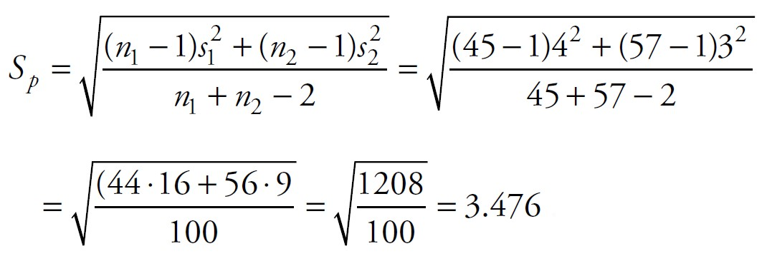
First we check the ratio of the sample variances to test the assumption of equal variances:
The ratio is less than 2, so that according to our guidelines our formulas apply. Next, we compute the pooled standard deviation $S_{p}$:
Ch 5: Estimation – Confidence Intervals for Difference of Means – Equal Variances

Slide 45
Note that $S_{p}$ is between the two original variances. Next, we go for the joint standard error SE:
Finally we need to find the multiplier $t_{p}$ = TINV(1 – p,df ), where df = $n_{1}$+ $n_{2}$ - 2 = 100 :
But now we have all ingredients in place to compute the given confidence interval.
It goes from (19 - 21) - 1.984 ⋅ 0.6931 = -3.3751 to (19 - 21) + 1.984 ⋅ 0.6931 = -0.62489.
Ch 5: Estimation – Confidence Intervals for Difference of Means – Equal Variances

Slide 46
Thus, our 95 percent confidence interval for the difference of means is (−3.3751, −0.62489).
In particular, we can say with 95 percent certainty that the difference of population means ${\text{m}}_{2}$− ${\text{m}}_{1}$ is negative, which implies that ${\text{m}}_{2}<$ ${\text{m}}_{1}$.
In other words, we are 95 percent sure that women spend less money, on average, than men at soccer games.
This seems obvious, considering the sample means for men and women, but just because one sample mean is less than another does not imply that the first population mean is necessarily less than the other population mean.
The point of the preceding example is that in this case we can infer from the sample about the population, and we can even specify the degree of certainty.
Ch 5: Estimation – Confidence Intervals for Difference of Means – Equal Variances

Slide 47
Note that $t_{p}$ = 1.9840 is close to 1.96, the multiplier we used for large sample size confidence interval for a single mean.
This makes sense, since for large sample sizes the t-distribution is close to the normal distribution.
However, for simplicity we will stick to using the t-distribution for difference of means regardless of the sample sizes.
Ch 5: Estimation – Confidence Intervals for Difference of Means – Equal Variances

Slide 48
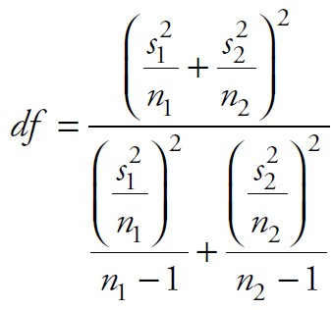
Unequal Variances
If the variances for the two populations are different, the confidence interval for ${\text{m}}_{2}$ - ${\text{m}}_{1}$ as before goes from (${\overline{x}}_{2}$ - ${\overline{x}}_{1}$)- $t_{p }$⋅ SE to (${\overline{x}}_{2}$ - ${\overline{x}}_{1}$)+ $t_{p }$⋅ SE
where SE = $\sqrt{\frac{s_{1}^{2}}{n_{1}}}$ + $\frac{s_{2}^{2}}{n_{2}}$ and ${ t}_{p }$= TINV (1 - p,df)
TINV is the inverse of the t-distribution with degrees of freedom
This procedure is similar to the one before but the degree of freedom for the t-distribution is a lot more complicated.
(use the nearest integer) and p is the confidence interval to compute
Ch 5: Estimation – Confidence Intervals for Difference of Means – Unequal Variances
Notes:
The procedure in the case of unequal variances is similar except that the formula to compute the degrees of freedom for the t-distribution is different (and much more complicated).

Slide 49
Example
A female student did poorly in a class and suspects the teacher is biased against women. She complains to the department chair who investigates the situation. The chair selects a random sample of 21 women and 9 men who have previously taken a class with the teacher. It turns out that the average grade for the men is 3.4 with standard deviation 0.9 and for the women it is 2.9 with a standard deviation of 1.5.
What can you conclude?
Ch 5: Estimation – Confidence Intervals for Difference of Means – Unequal Variances

Slide 50
First, we need to decide on a confidence interval.
We choose a 90 percent confidence interval (which means that we are somewhat favorably disposed toward the student).
Next, we check the ratio of the two standard deviations to determine which of our procedures applies:
Since that ratio is not between 0.5 and 2, we need to assume unequal variances. We compute the standard error SE:
Ch 5: Estimation – Confidence Intervals for Difference of Means – Unequal Variances

Slide 51
The multiplier $t_{0.90}$= TINV (0.1,df ) , but the degree of freedom is hard to compute:
The next closest integer to that value is 24, so we know that df = 24. Thus
$t_{0.1}$ = TINV (0.1,124) = 1.7109
Now we have all the ingredients so that the 90 percent confidence interval goes from
(3.4 - 2.9) - 0.4440 ⋅ 1.7109 = -0.2596 to
(3.4 - 2.9) + 0.4440 ⋅ 1.6572 = 1.2596
Ch 5: Estimation – Confidence Intervals for Difference of Means – Unequal Variances

Slide 52
This means, in particular, that our 90 percent confidence interval includes 0, and if the difference of means was indeed 0, there would be no difference in the scores of men and women.
Thus, it is perfectly possible, based on our calculations, that on average the instructor in question shows no bias toward men or women. Therefore, the department chair will dismiss the accusation.
Note that this does not mean that there truly is no bias; it is just that based on the available data we cannot conclude that there is.
Ch 5: Estimation – Confidence Intervals for Difference of Means – Unequal Variances
Notes:
The question of whether there is or is not a difference in the average score is actually better suited for a “test of hypothesis,” which we will tackle in the next chapter. But first we want to apply the concept of estimation to proportion.

Slide 53
For example, we might be interested in figuring out whether consumption of wine or beer has a different impact on a person’s concentration.
We could divide our participants at random into two groups, give wine to one and beer to the other, and measure the level of concentration for each group. This would be a difference of means situation, just as we covered already.
Alternatively, I could give everyone in my population wine, measure their level of concentration, then (after waiting an appropriate time) give everyone beer, and again measure their concentration.
This is advantageous, for example, if the total available sample size is small.
We will not develop this situation here but refer the reader, for example, to www.real-statistics.com/students-t-distribution/paired-sample-t-test/ for a nice discussion of this situation.
Ch 5: Estimation – Confidence Intervals for Difference of Means – Unequal Variances
Notes:
Note that another difference of means situation applies in the case of paired differences. This situation arises if we take two measurements from each member of a population.

Slide 54
Example
The General Social Science survey from 2008 includes data
provided by a random sample of adults in the United States.
You will find, among many other variables, answers to the question: Did humans develop from animals?
Based on that sample data, provide an estimate of how many people in the entire United States think that way.
www.betterbusinessdecisions.org/data/gss2008-short-2.xls
Ch 5: Estimation – Estimating Proportions
Notes:
As we mentioned in the previous chapter, many variables are categorical not numerical, so that the idea of estimating the mean does not even apply (since there is no mean). In special cases, however, we can resort to the idea of proportions and we could try to estimate them. This section will explain how that works.

Slide 55
Looking at the file we find the data for that question in column AH. The data is categorical, so the first thing we need to do is count all the “true” and all “false” values.
As we learned in Chapter 2, Excel’s Pivot tool will do that for us. Here are the steps, in case you forgot:
Click on the “Insert” ribbon and select the “Pivot” menu choice
Make sure the entire table is selected; then click “OK”
Drag the field “SCI: HUMANS DEVELOPED FROM ANIMALS” onto the Row Fields
Then drag the same field also onto the Value Fields
Ch 5: Estimation – Estimating Proportions

Slide 56
This should finish the pivot table (see Figure 5.7) and show that 651 out of 1,316 answered “false” while 665 out of 1,316 answered “true.”
Ch 5: Estimation – Estimating Proportions

Slide 57
Incidentally, the total number of people participating in this survey was 2,023 but only 1,316 answered this particular question.
Thus, as far as analyzing this question is concerned, the sample size is n = 1,316.
To phrase this as a proportion problem, we need to define success (and failure): We call it a success if someone believes that humans developed from animals, since then the probability of success p is exactly what we want to know.
What we do know is the ratio of success for our sample, which is $\hat{p}$ = $\frac{665}{1316}=0.5052$
To finish the problem, we need to know the standard error SE and the multiplier m, as is usual for all confidence intervals.
Ch 5: Estimation – Estimating Proportions

Slide 58
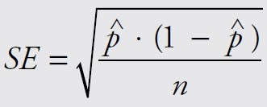
Estimating Proportions
Suppose x is a binomial random variable with probability of success p. If we take a random sample of size n, we can compute the sample proportion of success $\hat{p}$ as $\hat{P}$ = $\frac{x}{n}$
where x counts the number of successes
the standard error SE of the sample is
we can compute a confidence interval for p from
where $z_{p}$= 1.645 for a 90 percent confidence interval
$z_{p}$ = 1.96 for a 95 percent confidence interval
$z_{p}$ = 2.54 for a 99 percent confidence interval
This procedure is valid as long as there are at least 10 successes and 10 failures.
Ch 5: Estimation – Estimating Proportions

Slide 59
Now we can complete our example. Note that there were over 600 successes and failures so that the assumptions of our procedure are satisfied.
We know that $\hat{P}$ = $\frac{665}{1316}$ = 0.5052
so that the standard error is
Finally, suppose we want to compute a 95 percent confidence interval.
It goes from $\hat{p}$− 1.96 SE = 0.5052 − 1.96 ⋅ 0.0138 = 0.47815
to $\hat{p}$ + 1.96 SE = 0.5052 + 1.96 ⋅ 0.0138 = 0.53225
Ch 5: Estimation – Estimating Proportions

Slide 60
Instead of providing a point estimate for an unknown population parameter we provide an interval instead, called confidence interval.
The interval is based on a random sample of size n.
Three particular confidence intervals are most common: a 90 percent, a 95 percent, or a 99 percent confidence interval (other intervals are possible).
Each interval has the form:
where P is a point estimator for the parameter being estimated
SE is the standard error
m is a multiplier based on the standard normal or the t-distribution
The quantity m ⋅ SE is known as the margin of error.
Ch 5: Estimation – Summary

Slide 61
Population mean μ, large sample:
point estimator P = $\overline{x}$
standard error SE = $\frac{s}{\sqrt{n}}$
multiplier m = 1.645, 1.96, or 2.54
Population mean μ, small sample:
point estimator P = $\overline{x}$
standard error SE = $\frac{s}{\sqrt{n}}$
multiplier m = TINV(0.05, df ), TINV(0.025, df ), or TINV(0.005, df ) with df = n − 1
Ch 5: Estimation – Summary

Slide 62
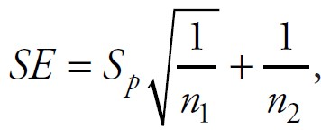
Difference of means $u_{2}$− $u_{1}$, equal variances
point estimator
pooled standard deviation
standard error
multiplier m = TINV(0.05, df ), TINV(0.025, df ), or TINV(0.005, df ) with df = $n_{1}$+ $n_{2}$ − 2
Ch 5: Estimation – Summary

Slide 63
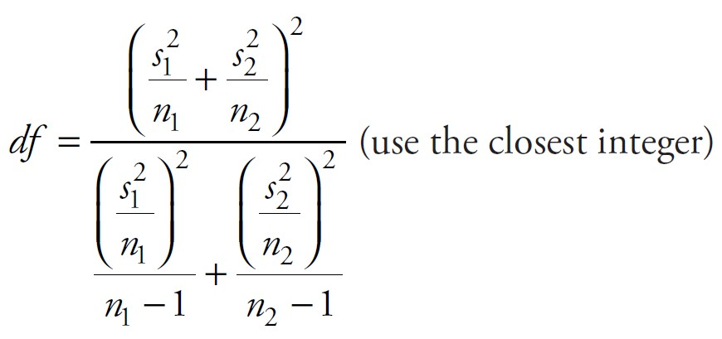
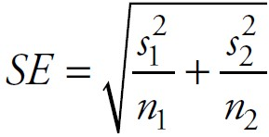
Difference of means $u_{2}$− $u_{1}$, unequal variances
point estimator
standard error
multiplier m = TINV(0.05, df), TINV(0.025, df), or TINV(0.005, df) with
Ch 5: Estimation – Summary

Slide 64
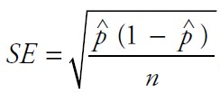
Probability of success:
point estimator
$\hat{P}$ = $\frac{x}{n}$
standard error
multiplier m = 1.645, 1.96, or 2.54
The preceding multipliers refer, in that order, to a 90 percent, 95 percent, and 99 percent interval.
The certainty of the estimate is denoted by its confidence level.
Ch 5: Estimation – Summary

Slide 65
Excel Demonstration
Company P wants to estimate the mean sales volume for all employees within the company. The sales director selects a sample of employees and calculates the average sales. The director now wants to be able to construct a confidence interval for the average of sales for the entire population of sales representatives in the company. The director decides that a 95 percent confidence level is sufficient and pulls the average sales from a sample of 14 representatives:
Ch 5: Estimation – Excel Demonstration

Slide 66
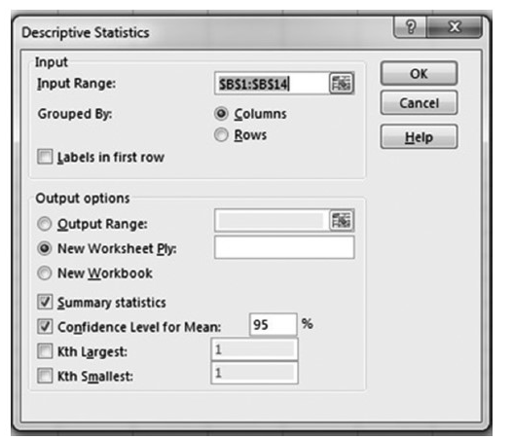
Step 1:
Insert the data into Excel with the labels in column A and the numbers in column B.
Run the descriptive statistics: Go to “Data | Data Analysis| Descriptive Statistics.”
For the “Input Range,” select Cells B1 through B14.
Check the “Summary Statistics” and the “Confidence Level for Mean” boxes
Type in 95 percent into the “Confidence Level” field.
Compare your input with Figure 5.8; then click OK.
Step 2:
Figure 5.8 Parameters for the descriptive statistics procedure
Ch 5: Estimation – Excel Demonstration

Slide 67
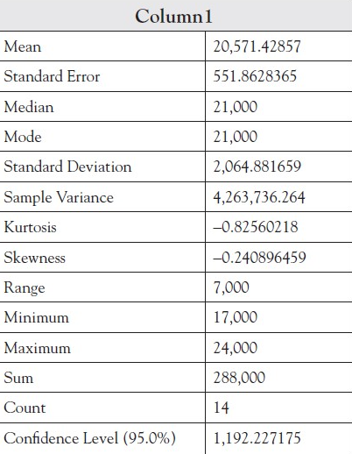
After you click OK, the descriptive statistics are provided, which are as follows:
Ch 5: Estimation – Excel Demonstration

Slide 68
Construct the upper and lower limits of the confidence interval. Recall that the “confidence level” is the product of the appropriate multiplier and the standard error.
Lower Limit: Mean (20,571.42) - Confidence Level (1,192.22)
= 19,379.20
Upper Limit: Mean (20,571.42) + Confidence Level (1,192.22)
= 21,763.64
Step 3:
You could write the 95 percent confidence interval as:
$19,379.20 ≤ μ ≤ $21,763.64
In other words, you can be 95 percent confident that the average sales per representative is somewhere between $19,379.20 and $21,763.64.
Ch 5: Estimation – Excel Demonstration

