Slide 1
Using Statistics for Better Business Decisions
Justin Bateh and Bert G. Wachsmuth
Copyright © Justin Bateh and Bert G. Wachsmuth, 2016. All rights reserved.

Slide 2
Chapter 1 Statistics and Statistical Software
Using Statistics for Better Business Decisions
Copyright © Justin Bateh and Bert G. Wachsmuth, 2016. All rights reserved.

Slide 3
Learning Objectives
Set up Microsoft Excel to run statistical analyses
Understand the importance of random sampling
Demonstrate how to use Microsoft Excel to identify a random sample
Understand basic vocabulary in the statistics field
Explain the importance in using statistics for business decision making
Identify the sources and types of data used in business
Ch 1: Statistics and Statistical Software – Learning Objectives

Slide 4
Statistics – is the study of making sense of data
Descriptive statistics
involves collecting data, summarizing it, and generally “telling the story” behind the data
helps describe the data and lets the reader understand the context in which any results should be interpreted
Inferential statistics
uses data collected from a subset of the overall study to draw conclusions about the whole
Ch 1: Statistics and Statistical Software – Introduction

Slide 5
Example:
A tax auditor is responsible for 25,000 accounts. The auditor wants to know how many of these accounts are in error (resulting in a loss of revenue) and how this compares to a (fictional) nationwide error rate of 2.5 percent.
Ch 1: Statistics and Statistical Software – Introduction

Slide 6
Identify the objective
How does the error rate for a particular tax auditor compare to the nationwide average?
Collect the data
The auditor investigates all 25,000 accounts and finds errors with 1,050 of them (say).
Analyze the data
In this case, we simply compute that 1,050/25,000 = 4.2 percent of accounts are in error.
Report the analysis
Based on our data analysis we conclude that 4.2 percent of the accounts are in error.
Since the national error rate is 2.5 percent, more accounts than usual are in error.
Ch 1: Statistics and Statistical Software – Introduction
Notes:
In real-world problems you frequently have to combine descriptive and inferential statistics.
So far we have conducted descriptive statistics: we computed the exact error rate for one auditor and compared it to the national error rate.
Note that the data analysis here, such as it is, was done with the help of a simple calculator. More commonly, special software is used to help with the data analysis, and in fact with all stages of a statistical analysis. In this text we will use Microsoft Excel (any one of the most recent versions should work) to help us perform statistical analysis.

Slide 7
When we collect data, we have the option of obtaining data from:
Primary sources
sources of data in which the person collecting the data is also using it
Secondary sources
data sets that the person running a study did not collect, but instead were collected from another individual or institution
Ch 1: Statistics and Statistical Software – Introduction
Notes:
The previous example has the big drawback that it would be very time-consuming to analyze all 25,000 accounts. It would be easier to select only a handful of them, analyze those, and then use the results from that subset to make inferences about all accounts.
Since we are using the analysis of a sample to draw conclusions about all 25,000 accounts, we now engage in inferential statistics.

Slide 8
Population
stands for the set of all measurements of interest
Sample
denotes any subset of measurements selected from the population
Ch 1: Statistics and Statistical Software – Introduction

Slide 9
Table 1.1 Examples of populations and samples
Population | Sample
Set of all photographs of Mars | Pictures from a specific region of Mars
Set of heights of all soldiers in the U.S. Army | Heights of soldiers from the 5th Infantry Division
All water quality measurements from the Hudson River | Water quality measurements taken on July 24, 2015
Set of all problems that can be solved using statistics | Problems that we will solve in this class
Ch 1: Statistics and Statistical Software – Introduction

Slide 10
Variable – a characteristic or property of a population where the observations can vary
Problem definition
What is the population of interest and what are the variables to be investigated?
Data collection
Describe and select a sample from the population.
Data analysis
Make statistical inferences from the analysis of the sample and apply them to the population.
Analysis reporting
Report the inference together with a measure of reliability for the inference.
Ch 1: Statistics and Statistical Software – Introduction

Slide 11
Example:
A tax auditor is responsible for 25,000 accounts. How many of these accounts are in error (resulting in a loss of revenue), and how does this compare to a (fictional) nationwide error rate of 2.5 percent?
Defining the problem
The entire population consists of all 25,000 accounts, and the variable to be investigated is whether an account is in error or not.
Thus, we have defined one variable, which has a total of 25,000 values.
Data collection and summary
The auditor decides to select 200 accounts at random, somehow, tests each of them, and finds that 8 of them are in error.
Ch 1: Statistics and Statistical Software – Introduction

Slide 12
Data analysis
Some statistical theory is applied to allow drawing a conclusion from the sample of 200 accounts and applying it to all 25,000 accounts.
In this case, the likely theory involves computing 8/200 = 4 percent.
Analysis reporting
Based on our data analysis we infer that approximately 4 percent of the accounts will be in error.
Additional theory (which we will cover in Chapter 5) shows that our guess has an error of ±0.9 percent.
Thus, it seems that our accounts contain more errors than the national average of 2.5 percent.
Ch 1: Statistics and Statistical Software – Introduction
Notes:
The analysis of the data is usually done by using a calculator, or— more frequently these days—with the help of a software package. In this textbook we will use Microsoft Excel (any recent version of Excel should work) to help us perform statistical analysis.

Slide 13
Random sample of size n – a sample that is selected by a process such that any other sample of that size n has the same chance of being selected
Example:
Find the average income for people living in New York City (NYC).
The most accurate approach apparently would be to ask everyone living in NYC their income, add up all the figures, and divide the sum by the total number of people asked (which will give the precise average).
Ch 1: Statistics and Statistical Software – Samples and “Random Samples”

Slide 14
However, that is not only impractical, it would not even work:
When people are asked their income not everyone will answer (for a variety of reasons).
People might not answer truthfully (again for a variety of reasons).
It will be difficult to physically track down everyone living in NYC.
By the time the last people are asked, others have moved in or out of NYC already.
Ch 1: Statistics and Statistical Software – Samples and “Random Samples”
Notes:
The definition might seem abstract and perhaps not so useful.
We could paraphrase it by saying that a random sample is a sample where the selection has taken place without any bias of any sort.
If there was no bias of any kind in making a selection of n objects, then any other set of n objects would have had the same chance of being selected. Thus, no bias implies a random sample.
There are cases where it is not only more efficient to work with a random sample, but it might even give more accurate answers than trying to work with the population.

Slide 15
Therefore, instead of finding the exact—and arguably elusive— average, we should try to estimate it.
To randomly select a small sample, say of size n = 1,000, of people living in NYC and find the average income of that sample (which is perfectly within our capabilities).
Then we draw conclusions from that sample about the whole population.
Ch 1: Statistics and Statistical Software – Samples and “Random Samples”
Notes:
Note that according to the U.S. Constitution, Article 1, Section 2, a census needs to be conducted every 10 years so that the people can have a proper proportion of representation in the U.S. House of Representatives.
Instead of attempting to count everyone, as seems required, many statisticians argue that using a carefully selected random sample would in fact give more accurate results.
But using such inference might be in violation of the constitution depending on the exact meaning of “census.”

Slide 16
How do I select a random sample of size 1,000 from the population of inhabitants of NYC?
Open the latest NYC phone book.
Select one page “at random” (perhaps by throwing the book in the air).
Select 1,000 people starting from that page that the book opens up on.
Call those people and ask them for their income. Compute the average of that group and say that this average is representative for the average income of all people in NYC, approximately.
Ch 1: Statistics and Statistical Software – Samples and “Random Samples”
Notes:
But this is not at all a procedure to obtain a “random sample”: all people selected will most likely be from one borough, or all may have a name starting with “Mac” (and are therefore likely to be of Irish ancestry, which introduces bias).
Thus, this is not a random sample. In fact, it turns out that to select a random sample you need to carefully and deliberately select people from all sociological backgrounds, all races, all cultures, and so on.
In other words, contrary to what you might think a random sample must be selected very deliberately in this case.

Slide 17
Random Sample Selection Procedure
Example: Select a random sample of size n = 5 from a population of 2,000 measurements.
Label all measurements from 1 to 2,000, in any order.
Start a computer program that can generate random numbers.
Use that computer program to generate five unique random numbers between 1 and 2,000.
Select the five measurements from the total population located at those random positions.
Ch 1: Statistics and Statistical Software – Random Sample Selection Procedure
Notes:
This procedure will give a random sample (assuming the computer’s random number generator is working correctly).

Slide 18
Another approach that works particularly well using Excel:
List all measurements from 1 to 2,000, in any order.
Create random numbers between 0.0 and 1.0 and store them with each measurement.
Sort all numbers according to their associated random number between 0 and 1.
Pick the first five elements from the list of measurements.
Ch 1: Statistics and Statistical Software – Random Sample Selection Procedure

Slide 19
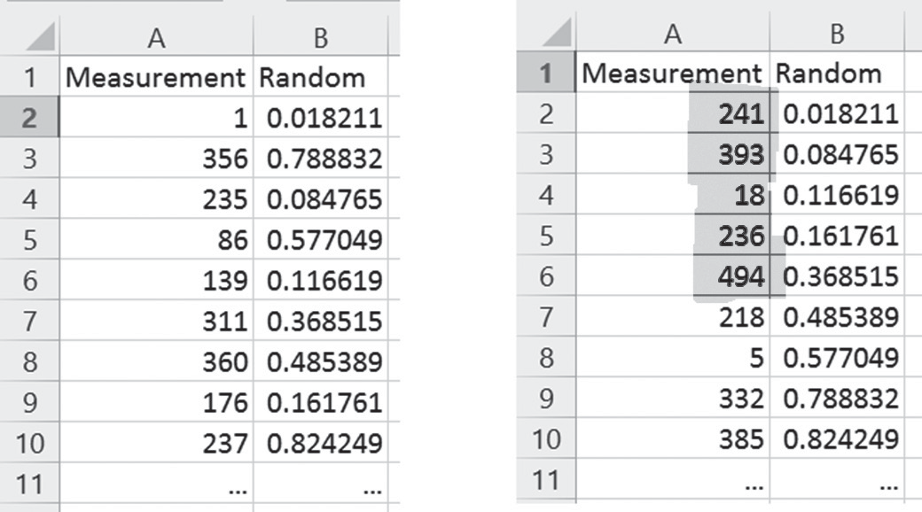
Figure 1.1 Selecting a random sample in Excel
Values in original order with associated random number
Values sorted by associated random number (column B)
Ch 1: Statistics and Statistical Software – Random Sample Selection Procedure

Slide 20
Variables and Distributions
Categorical variables
variables that have a limited number of distinct values or categories
sometimes called discrete variables
Numeric variables
refer to characteristics that have a numeric value
usually continuous variables, that is, all values in an interval are possible
Ch 1: Statistics and Statistical Software – Variables and Distributions

Slide 21
Types of Categorical variables
Ordinal variables
represent categories with some intrinsic order (e.g., low, medium, high; or strongly agree, agree, disagree, strongly disagree)
could consist of numeric values that represent distinct categories (e.g., 1 = low, 2 = medium, 3 = high)
Note that this does not turn them into numeric variables; the numbers are merely codes. To best remember this type of variable, think of “ordinal” containing the word “order.”
Ch 1: Statistics and Statistical Software – Variables and Distributions

Slide 22
Types of Categorical variables
Nominal variables
represent categories with no intrinsic order (e.g., job category, company division, and race)
could also consist of numeric values that represent distinct categories (e.g., 1 = male, 2 = female)
Ch 1: Statistics and Statistical Software – Variables and Distributions

Slide 23
Example:
An experiment is conducted to test whether a particular drug will successfully lower the blood pressure of people. The data collected consists of the sex of each patient, the blood pressure measured, and the date the measurement took place. The blood pressure is measured three times, once before the patient was treated, then one hour after administrating the drug, and again two days after administrating the drug.
What variables comprise this experiment?
Ch 1: Statistics and Statistical Software – Variables and Distributions

Slide 24
Table 1.2 Recording variables and values in tabular form
Patient ID (nominal) | Sex (nominal) | Date (ordinal) | Pressure (pre) (numeric) | Pressure (post) (numeric) | Pressure (after) (numeric)
1 | Male | January 1, 2014 | 180 | 135 | 150
2 | Female | January 1, 2014 | 170 | 140 | 145
3 | Male | January 3, 2014 | 200 | 130 | 140
4 | Male | January 7, 2014 | 190 | 160 | 190
Ch 1: Statistics and Statistical Software – Variables and Distributions
Notes:
The characteristics measured in the experiment seem to be the patient’s sex, blood pressure, and treatment date, so it looks like we need three variables to capture the outcomes: sex (nominal), blood pressure (numeric), and date (ordinal). But the fact that the blood pressure is measured three times does not quite fit this scheme. In fact, for each patient participating in the study we actually measure five characteristics: sex, treatment date, blood pressure prior to treatment, blood pressure right after treatment, and blood pressure two days after treatment.
Thus, we really have five variables, not three. In fact, we also have one additional variable, namely, the ID (or name) of the patient. Thus, the data collected for four (fictitious) patients is recorded in six variables as shown in Table 1.2.
Note that many statistical software packages follow this convention to setup variables in columns, one column per variable, and to record the values for each case in rows.

Slide 25
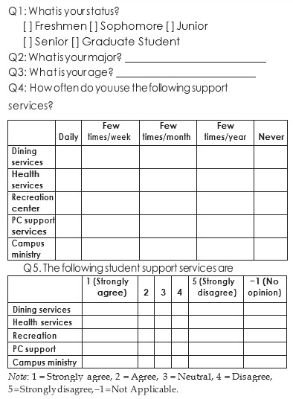
Example: Consider the following survey, given to a random sample of students taking a university course:
The survey consists of a total of 13 variables:
Q1 (status) is an ordinal variable
Q2 (major) is nominal
Q3 (age) is numeric
Q4 consists of five variables (one for each row of the table) – all being ordinal
Ch 1: Statistics and Statistical Software – Variables and Distributions

Slide 26
Q5 again consists of five ordinal variables
Note in particular that the five variables in question 5 are not numeric.
The numbers are simply codes for particular categories.
However, ordinal variables share some characteristics of numerical ones, as we will see in Chapter 3.
Ch 1: Statistics and Statistical Software – Variables and Distributions
Notes:
Following our previous example, we should introduce one additional nominal variable to capture the ID of each subject. This allows us to have a unique identification for each data record.
When the results of a survey or an experiment are recorded, the outcomes usually vary, and the variation of each variable usually occurs with different frequencies.
For example, a survey given to a random sample of U.S. citizens might record the sex of the subject. The frequencies of the values for this variable will likely be approximately 52 percent female and 48 percent male. Recognizing patterns in the frequencies of outcomes is in fact one of the goals of statistics.

Slide 27
Distribution of a variable – set of all possible values of a variable and the associated frequencies or probabilities with which these values occur
Heterogeneous distribution
distribution of values of a variable where all outcomes are nearly equally likely
Homogeneous distribution
distribution of values of a variable that cluster around one or more values, while other values are occurring with very low frequencies or probabilities
Ch 1: Statistics and Statistical Software – Variables and Distributions

Slide 28
Example:
Suppose you are conducting a survey that tries to determine whether women are typically shorter than men. Thus, your survey, administered to 100 randomly selected people, asks for the respondent’s sex and height.
Do you anticipate homogeneous or heterogeneous distributions from these variables?
Ch 1: Statistics and Statistical Software – Variables and Distributions

Slide 29
Since approximately half of all people are male and half are female and the survey was given to 1,000 randomly selected participants, there should be approximately the same number of men and women queried.
Thus, the variable sex should have a heterogeneous distribution—all possible values are just about equally likely.
The second variable, height, however, will likely cluster around one or two most frequent values.
Or conversely, few people are really short (4 ft. or less) or really tall (7 ft. or more), so this variable should be homogenously distributed.
Ch 1: Statistics and Statistical Software – Variables and Distributions

Slide 30
Example:
Suppose a company issues sales reports for two years, 2014 and 2015, as shown in Figure 1.2. We can consider this report as having two variables (v_2014 and v_2015, say), each one having four values (for North, South, East, and West, separately).
Are the distributions of values hetero- or homogeneous?
The values for the 2014 variable (v_2014 if you like) are pretty close to each other.
The values for the 2015 variable (v_2015 in our terminology) differ widely.
Ch 1: Statistics and Statistical Software – Variables and Distributions

Slide 31
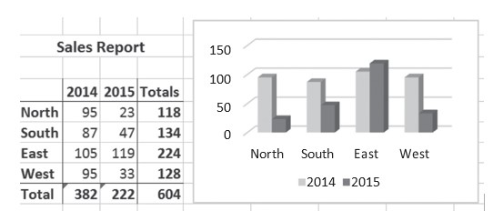
Figure 1.2 A sample company sales report
If all bars of a distribution are approximately equally high, the variable is heterogeneous.
If some bars of a distribution dominate the others, the variable is homogeneous.
Ch 1: Statistics and Statistical Software – Variables and Distributions
Notes:
The values for the 2014 variable (v_2014 if you like) are pretty close to each other.
In the chart you can see that all 2014 bars are approximately of equal height.
If we looked at the original figures, we would find an (about) equal amount of sales for North, South, East, and West, and no region would stick out, particularly. Thus, each region is equally likely in terms of number of sales—the distribution is heterogeneous (if we checked where an individual, randomly selected, came from, each region would be approximately equally likely).
The values for the 2015 variable (v_2015 in our terminology) differ widely.
In Figure 1.2 the 2015 bars are of different heights, with “East” being by far the highest.
If we would look at the original figures, we would find that most sales were made in the East. Thus, a sale from the East is much more likely than from any other region—the distribution is homogeneous (if we checked where an individual, randomly selected, came from, she would most likely come from the east).
This seems somehow counter intuitive:
If all bars of a distribution are approximately equally high, the variable is heterogeneous.
If some bars of a distribution dominate the others, the variable is homogeneous.

Slide 32
Installing the Analysis ToolPak in 2013 Microsoft Excel
(Note that Excel for Mac does not include this ToolPak. If you are using a Mac, try and install the free software from http://www.analystsoft.com/en/products/statplusmacle/ instead.)
Start Excel as usual with a blank sheet.
Click on the “File” button in the top left corner.
Click on “Options” near the bottom of the menu.
Highlight the “Add-Ins” option on the list on the left.
Under the “Manage” section, make sure Excel Add-ins is selected and click the “GO” button as shown in Figure 1.3.
Another dialog box will appear; check the “Analysis ToolPak” and click “OK.” (Caution: Be sure not to install the Analysis ToolPak—VBA version.)
Ch 1: Statistics and Statistical Software – Installing Analysis ToolPak in Microsoft Excel

Slide 33
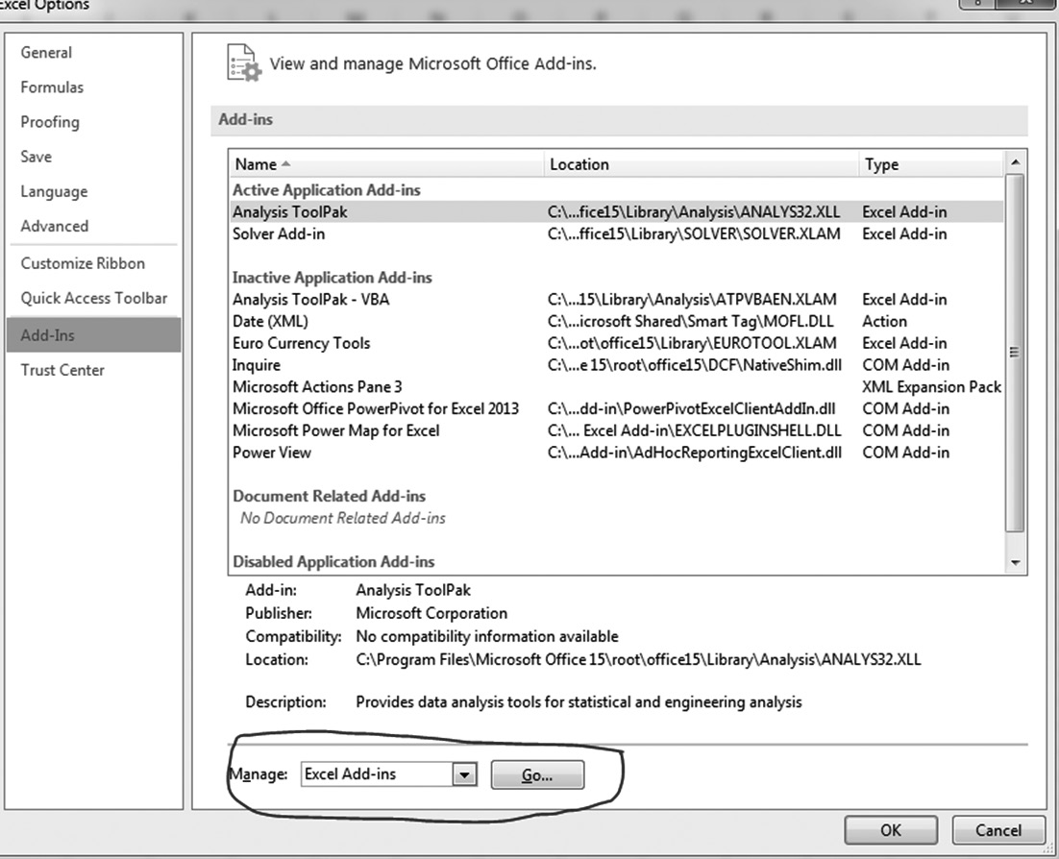
Figure 1.3 Dialog to install the Analysis ToolPak for Excel for Windows
Ch 1: Statistics and Statistical Software – Installing Analysis ToolPak in Microsoft Excel

Slide 34
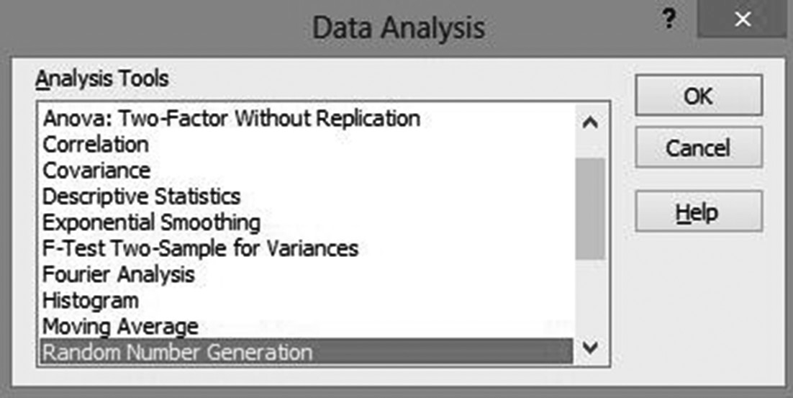
The functions from the Analysis ToolPak will now be available in the “Data” ribbon as the right-most entry, named “Data” (and not in the “Add-ins” ribbon as you might expect).
The specific functions in that add-in are the same for most versions of Excel for Windows.
If you select the “Data Analysis …” option under “Data” you will see the procedures as shown in Figure 1.4 for performing statistical analysis on data in your spreadsheet.
Figure 1.4 Procedures of the Analysis ToolPak
Ch 1: Statistics and Statistical Software – Installing Analysis ToolPak in Microsoft Excel

Slide 35
Excel Demonstration
Company S – a mid-sized accounting firm with approximately 600 employees.
As a service-based organization, Company S provides services such as general accounting, bookkeeping, tax preparation, software consultation, controller services, business accounting, and payroll services.
It comprises a management team, support staff, and certified public accountants (CPAs).
Management is responsible for developing strategies to generate new clients, while the support staff and CPAs fulfill the service requests of their clients.
Ch 1: Statistics and Statistical Software – Excel Demonstration
Notes:
In this textbook we will follow two fictitious companies, Company S and Company P.
Both of these companies will be faced with common work- place problems as we proceed through the text, and you will be provided with demonstrations on how to arrive at answers for these problems using statistics and Microsoft Excel. Here is a background of the two companies.

Slide 36
Company P – a large manufacturer of paper products with approximately 1,000 employees and supplies various paper products to retailers around the United States.
These products include industrial supplies, food service supplies, sanitary supplies, and packaging supplies.
As a product-based organization, Company P, in addition to management and support staff, has a sales force that is broken into sales teams, with each team given a regional territory.
Each sales team is responsible for establishing and managing relationships with retailers and the sale of products to retailers within their territory.
Ch 1: Statistics and Statistical Software – Excel Demonstration

Slide 37
Using Excel to Select a Random Sample
Problem: Company P would like to interview a random sample of 5 of the top 20 clients in the company. Use Excel to select a random sample of size 5 from the population of 20 clients.
The task is to assign a random number to each client and then sort by this number in order to pull a random sample of five clients.
Ch 1: Statistics and Statistical Software – Excel Demonstration

Slide 38
Using Excel to Select a Random Sample
First, enter the 20 client names into a new Excel worksheet into column A.
Then, next to each client name, enter the Excel function =RAND().
Note that in order to enter an Excel function, you must start with a leading equal sign.
If it worked you should see a random number between 0 and 1 in that cell but when you click on it you will see the =RAND() function in the Excel edit bar.
You could now type this function into the remaining 19 cells but to speed up the process, “copy and paste” the entry from the first cell value into the following 19 cells in column B. See Figure 1.5.
Ch 1: Statistics and Statistical Software – Excel Demonstration

Slide 39
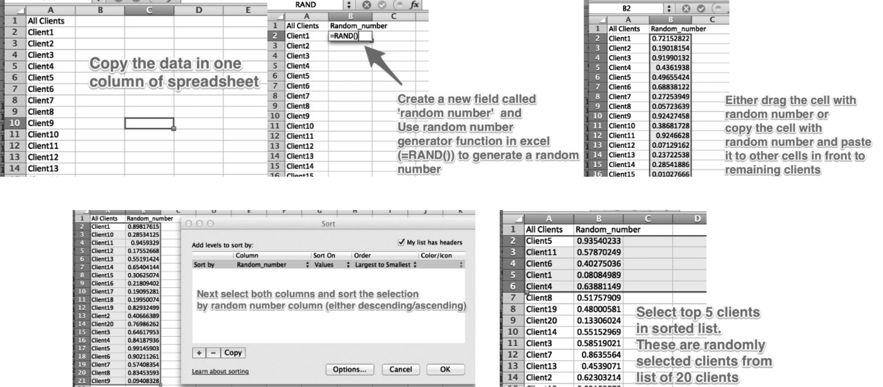
Figure 1.5 Selecting a random sample from a list of client names
Ch 1: Statistics and Statistical Software – Excel Demonstration

